Slide 1
Management of Production - Exercise II
Structure of Production

Slide 2
Production Structure
The structure (physical lay-out and interdependence relations) of the transformations that together result in the constitution of the goods and services that an organization intents to deliver to their customers.

Slide 3
Production Economic Theory
Production occurs in a collective fashion by means of the division of labor.
Labor may be divided amongst producers and across groups formed by them.
It can be divided
- horizontally, which occurs simultaneously and necessarily among different producers, or
- vertically meaning that it occurs sequentially through time.
The crucial difference between vertical and horizontal division of labor is the importance assigned to the producer’s wear and tear (that is, on their plant and equipment) and their aging.
The division of labor has the capacity to generate inherently collective production which is different from the simple addition of individual productions.
If inherently collective, the division of labor increases productivity and/or combines the physical properties of different productions obtaining new properties not found without the aforementioned combination.
Inherently collective production (abbreviated collective production) under the circumstances of the division of labor requires the capacity of making reliable promises or commitments of production.
Bakers dedicate themselves to producing bread because they believe that they will be able to obtain other requirements for sustenance from other producers.
Neither producer would specialize if they did not rely on the other producer’s commitment to producing the goods required for their sustenance (the bakers in need of meat would not specialize in producing bread if they could not rely on the butcher’s commitment).
The commitment can take many forms, verbal, written, tacit or merely instinctive.

Slide 4
Production structure
The production structure is affected by the following factors:
production and economic conditions of the business entity,
results of marketing analyzes,
the level of capital adequacy of the entity,
efficiency of the use of labor resources,
degree of concentration and specialization of production,
economic advantage of the sector in relation to the rational system of land management.
A system made up of a rational representation of industries and their elements and activities so as to make a profit.
A system of materially, temporally and spatially arranged elements of production in industries with the aim of achieving profit.
The main goal in creating the company's production structure is to create the conditions for achieving PROFIT.

Slide 5
Production structure
In general, the production structure is a system consisting of a rational representation of the industries and their elements and activities to make the necessary profit from a successful business.
From the production perspective, the production structure represents a system of factual (materially), timed and spatially arranged elements of production in sectors, especially in terms of optimal solution of tangible energy, value and other links in order to create the prerequisites for making a profit.

Slide 6
Production structure in the primary production Agri-entity
Production structure in Agriculture
Plant Production Structure
Livestock Production Structure
Structure of non-agricultural activities
Structure of Crops on Agricultural Land (hectares, %)
Structure of Arable Crops (hectares, %)
Structure of Cereals (hectares, %)
Livestock structure (number of animals, dairy units, %)
Herd structure of the selected category (number of animals, dairy units, %)
Construction services
Agrotourism services
Transport services

Slide 7
The production structure is primary, decisive and at the same time a reflection of the target behavior of the business agro -entity . We assess it in terms of:
Material structure - divides production into smaller parts,
- defines and characterizes their relationships and elements.
The main criteria of the material structure are:
production profile,
production program,
output elements (products),
human participation in the production process,
technological processes.
Time structure - general time distribution of product production in a production unit. Specifically, it consists of a composition of the running time, which consists of a sum of times of work, downtime and technological process.
In terms of time, there is a dependence on:
seasons,
meteorological conditions,
crop demands for inputs in individual phases of the growing season.
The spatial structure includes the distribution and organization of production branches in the territory of a certain production-organizational unit as well as personal and material factors of production in a certain proposed area, depending on natural, economic and other specific conditions.
The aim is to carry out production with minimum requirements for individual elements of production.
Factors influencing the spatial structure of production are:
the size and shape of the production and organizational unit,
situational distribution of land, production, storage, etc. capacity,
production focus of the business unit and its internal departments,
communication network (main and secondary field roads),
distribution of transport, energy, labor and other resources.

Slide 8
Manufacturing industry
part of a production, a specific agricultural unit, which produces:
one product, or
several related products originating from the same source,
which, however, differ from others in:
subject of work
tool of work,
technology,
organization,
final product.

Slide 9
Agribusiness production industries
Agrobusiness
Crop production
Livestock production
Non-agricultural production
Transport
Set of Industries
Sub-set of Industry
Industry Groups
Individual Sectors
Cereals
Fodder
Vegetables
Pigs
poultry
Cattle
Tool rental
Construction
Personal
Freight
Transport of animals
Agricultural production

Slide 10
Methods of determining the scope of industries
balance sheet method the essence of which lies in balancing the needs and resources of individual production sectors of the agricultural entity . It's a laborious but fairly accurate way of determining scope.
economic-mathematical methods (linear programming methods). It is a way of processing data using modern computer technology. The Simplex method and other methods are used.

Slide 11
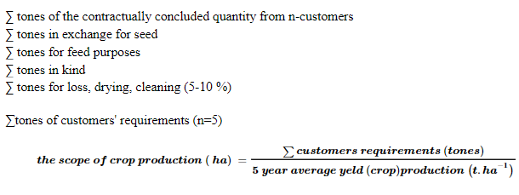
Determining the scope of the crop industry
z

Slide 12
Example 1
The solution
Assignment
1200 t - mill
300 t - feeding purposes
100 t - in kind
80 t – seed
60 t - losses
1740 t - total
1740 t / 5.2 t.ha ⁻¹ = 334.6 ha
In order for a given Agri-entity to meet all requirements, it should grow winter wheat on a minimum area of 334.6 ha.
Determine the extent of winter wheat cultivation and subcontracting in the „corn production area", if it is necessary to meet the following requirements: 1200t- mill, 300t - feeding purposes, 100t- sale to employees, 80t exchange for seeds, 60t losses by drying and cleaning. The average ha yield for the last 5 years was 5.2 t.

Slide 13
Example 2
According to the data entered in the Design of the Production Structure for a selected primary production agribusiness entity for the next 6 years, evaluate the effectiveness of crop production restructuring for (1) proposed period, (2) proposed period and (3) target solution.
The cost part is based on the initial level of unit costs of crops, considering the possible inflationary increase in input prices up to the target solution.
The implementation part is based on the expected growth of purchase prices of crops, also up to the target solution.
Using economic indicators, evaluate in which period the most economically favorable results are achieved in the restructuring of crop production sector in the surveyed agricultural entity.
Calculate and assess the variant without fodder on arable land, i.e. purely vegetable, without connection to the crop sectors and other variants with a significant (up to twice the distribution of fodder arable land) at the expense of current crop market sectors. At the same time, an increase of up to 33.3% in sales from the cattle breeding sector is expected.

Slide 14
 | Crop industry | 1. proposed period |  | 2. proposed period |  | 1. Period in EUR
 |  | Σ t | Production € .t ⁻¹ | Σ t | Production € .t ⁻¹ | Costs | Realization price | Economic result | Profitability rate
1 | winter wheat | 2500 | 116.2 | 2750 | 140
2 | spring barley | 730 | 115 | 1004 | 135
3 | corn for grain | 350 | 120 | 385 | 137.5
4 | peas | 240 | 280.9 | 260 | 487.5
5 | corn for silage | 4880 | 21.1 | 4890 | 23
6 | lantern sows | 1818 | 10.1 | 1938 | 11.5
7 | sugar beet | 4000 | 25 | 4000 | 27.9
8 | sunflower | 194 | 225.5 | 237 | 255.6
9 | oilseed rape | 60 | 300 | 100 | 315
10 | green peas | 30 | 170.9 | 66 | 182.6
11 | early potatoes | 158 | 170 | 132 | 185
12 | tobacco | 38 | 1361.1 | 32 | 1493.7
13 | vegetables | 300 | 100.1 | 200 | 110.5
14 | delicatessen cookie. | 13 | 117.8 | 45 | 126.2
15 | grapes | 90 | 410.5 | 95 | 514.5
16 | fruit | 35 | 149.4 | 42 | 169.3
17 | permanent meadows | 11 | 10.5 | 12 | 12
18 | perennial pastures | 29 | 7.2 | 32 | 8.5
19 | winter mixes | - | - | - | -
20 | spring mixes | - | - | - | -
RC = product realization price in € .t-1, MR = profitability rate, VN = own costs, HV = economic result, Economic result (profit or loss in €) = income (€) - own costs (€);

Slide 15
Example of a solution
 |  | 1. proposed period
 | Art. industry (crop) | ∑ t | Sale price EUR.t ⁻¹
1 | winter wheat | 2000 | 165.3
2 | spring barley | 500 | 180
3 | corn for grain | 100 | 195.5
4 | peas | 200 | 308.9
 |  | 1. proposed period
 | Crop product | ∑ t | Production EUR.t ⁻¹
1 | winter wheat | 2500 | 116.2
2 | spring barley | 730 | 115
3 | kuk. for grain | 350 | 120
4 | peas | 240 | 280.9
5 | silage corn | 4880 | 21.1
6 | lantern sows | 1818 | 10.1
∑ t * Sale price EUR.t ⁻¹
^{2000 t * 165.30 EUR.t-1}
= 330,600.00 EUR
^{Revenues in EUR}
∑ t * cost EUR.t ⁻¹
^{2500 t * 116.20 EUR.t-1}
= 290,500.00 EUR
^{Costs in EUR}
 |  | 1. proposed period
 | Art. industry (crop) | ∑ Costs EUR | ∑ Profit EUR | Economic result | Prof. rate
1 | winter wheat
Economic result= Profit-Costs
^{330,600.00 - 290,500.00}
^{= 40,100.00 EUR}
Prof. rate = (Ec. result / costs) * 100
^{(40 100.00 / 290 500.00) * 100}
^{= 13.80} %
The company does not sell fodder on the market, it is an input to the livestock production, it brings a return (profit) in the amount of their own costs.

Slide 16
Example 2 - Table 9
 |  | 1st period |  |  |  | 2nd period |  |  |  | Target period
 |  | Costs | Realization price | Economic result | Profitability rate | Costs | Realization price | Economic result | Profitability rate | Costs | Realization price | Economic result | Profitability rate
1 | winter wheat | 290500.00 | 330600.00 | 40100.00 | 13.80 | 385000.00 | 405000.00 | 20,000.00 | 5.19 | 795300,00 | 880200,00 | 84900.00 | 10.68
2 | spring barley | 83950.00 | 90000.00 | 6050.00 | 7.21 | 135540,00 | 147300,00 | 11760.00 | 8.68 | 114840.00 | 148875,00 | 34035.00 | 29.64
3 | corn for grain | 42000.00 | 19550,00 | -22450.00 | -53.45 | 52937.50 | 56829,00 | 3891,50 | 7.35 | 61740.00 | 63000.00 | 1260.00 | 2.04
4 | peas | 67416.00 | 61780.00 | -5636.00 | -8.36 | 126750.00 | 117986.00 | -8764.00 | -6.91 | 155540,00 | 152775,00 | -2765.00 | -1.78
5 | corn for silage | 102968,00 | 102968,00 | 0.00 | 0.00 | 112470,00 | 112470,00 | 0.00 | 0.00 | 126392.00 | 126392.00 | 0.00 | 0.00
6 | lantern sows | 18361.80 | 18361.80 | 0.00 | 0.00 | 22287,00 | 22287,00 | 0.00 | 0.00 | 24350.00 | 24350.00 | 0.00 | 0.00
7 | sugar beet | 100000.00 | 119600,00 | 19600,00 | 19.60 | 111600.00 | 126000.00 | 14400.00 | 12.90 | 120000.00 | 132800.00 | 12800.00 | 10.67
8 | sunflower | 43747,00 | 50071.40 | 6324.40 | 14.46 | 60577.20 | 66644.40 | 6067.20 | 10.02 | 78793.00 | 86686.60 | 7893.60 | 10.02
9 | oilseed rape | 18000.00 | 20100.00 | 2100.00 | 11.67 | 31500.00 | 35000.00 | 3500.00 | 11.11 | 67000.00 | 72000.00 | 5000.00 | 7.46
10 | green peas | 5127.00 | 7470.00 | 2343,00 | 45.70 | 12051.60 | 17529.60 | 5478.00 | 45.45 | 20160,00 | 31615.50 | 11455.50 | 56.82
11 | early potatoes | 26860.00 | 41159.00 | 14299.00 | 53.24 | 24420.00 | 37237.20 | 12817.20 | 52.49 | 23700.00 | 36000.00 | 12300.00 | 51.90
12 | tobacco | 51721.80 | 54309.60 | 2587,80 | 5.00 | 47798.40 | 51145.60 | 3347,20 | 7.00 | 49791,00 | 51285.00 | 1494,00 | 3.00
13 | vegetables | 30030.00 | 44820.00 | 14790.00 | 49.25 | 22100.00 | 31200,00 | 9100.00 | 41.18 | 27624.00 | 41832,00 | 14208.00 | 51.43
14 | delicatessen cookie. | 1531,40 | 2697,50 | 1166,10 | 76.15 | 5679.00 | 9783.00 | 4104.00 | 72.27 | 14637,00 | 24916.50 | 10279.50 | 70.23
15 | grapes | 36945,00 | 36900.00 | -45.00 | -0.12 | 48877.50 | 47984.50 | -893.00 | -1.83 | 67432.20 | 62342.40 | -5089.80 | -7.55
16 | fruit | 5229.00 | 6391.00 | 1162,00 | 22.22 | 7110.60 | 9063.60 | 1953,00 | 27.47 | 8947.40 | 12201.00 | 3253,60 | 36.36
17 | permanent meadows | 115.50 | 115.50 | 0.00 | 0.00 | 144.00 | 144.00 | 0.00 | 0.00 | 188.50 | 188.50 | 0.00 | 0.00
18 | perennial pastures | 208.80 | 208.80 | 0.00 | 0.00 | 272.00 | 272.00 | 0.00 | 0.00 | 367.50 | 367.50 | 0.00 | 0.00
19 | winter mixes
20 | spring mixes

Slide 18
Example 2- assignment
 | ∑ Costs 1-16 / 1000 | ∑ Profit 1-16 / 1000
∑profit CROP (in thousand €) |  |  | Economic result
Economic result CROP (in thousand €) |  |  |  | Profitability
Profitability rate - CROP |  |  | -13.9
∑ profit LIVESTOCK (in thousand €) | 516
Costs livestock (in thousands €)
Profitability rate LIVESTOCK | 1686
Costs (in thousand €) field. | Costs (crop + livestock)
Profit from the field. (in 1000 €.ha-1) |  |  | Economic result (crop+livestock) / area
Profitability rate
Efficiency

Slide 19
Example 2- solution
∑profit CROP (in thousand €) | 803,057 | 885,449 |  |  | 1071,942 | 1158,703 |  |  | 1605,505 | 1796,529
Economic result CROP (in thousand €) |  |  | 82,391 |  |  |  | 86,761 |  |  |  | 191,024
Profitability rate - CROP |  |  |  | 10,260 |  |  |  | 8,094 |  |  |  | 11,898
∑ profit LIVESTOCK (in thousand €) |  |  | -13.9 |  |  |  | 21.6 |  |  |  | 121.2
Costs livestock (in thousands €) | 516 |  |  |  | 572.6 |  |  |  | 662
Profitability rate LIVESTOCK |  |  |  | -2,694 |  |  |  | 3,772 |  |  |  | 18,308
Costs (in thousand €) field. | 1686 |  |  |  | 1659 |  |  |  | 1630
Profit from the field. (in 1000 €.ha-1) | 1319,057 |  |  |  | 1644,542 |  |  |  | 2267,505
Profitability rate |  |  | 0.041 |  |  |  | 0.065 |  |  |  | 0.192
Efficiency |  |  |  | 5.19244 |  |  |  | 6,589 |  |  |  | 13,770
 | 0.05192 |  |  |  | 0.06589 |  |  |  | 0.13770

Slide 22
Restructuring of industries
Restructuring means:
reclassify
to incorporate, or
set aside
.... industry into the production program of the Agri-entity .
The result of the restructuring is more efficient agricultural production.

Slide 23
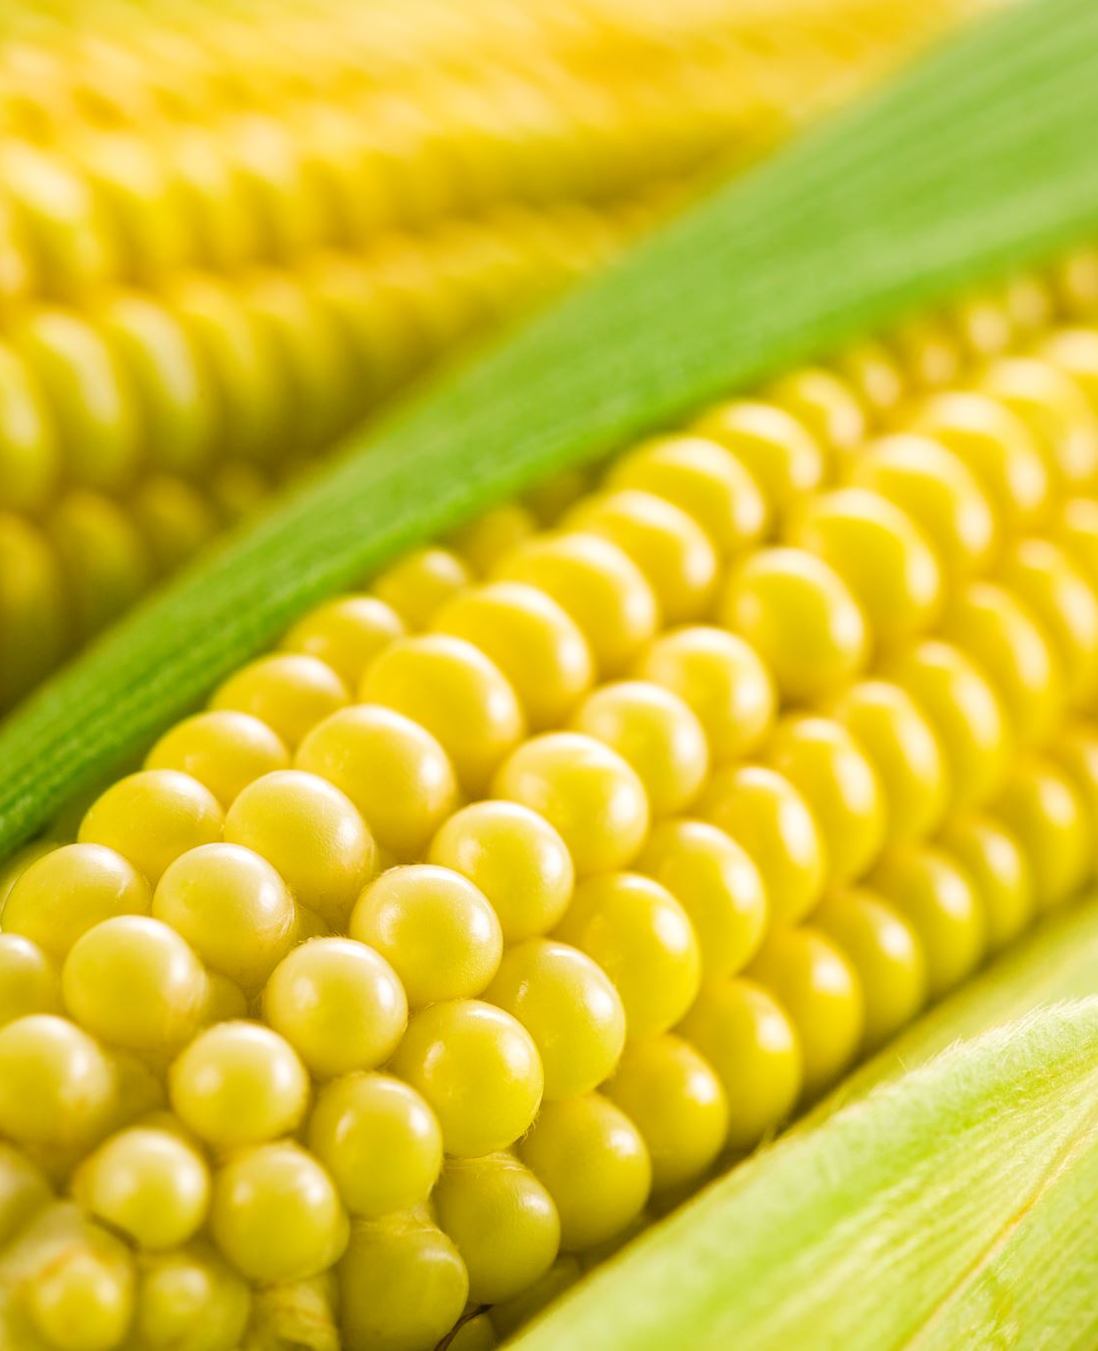
The results
third, i.e. the target solution, showed the best economic prosperity.
Sectors which most significantly participated in the achieved economic results :
sweet corn, potatoes and vegetables.
Economically unfavorable results were achieved by the production sectors :
corn and grains of peas.
We recommend reducing or eliminating these in the production structure.
We recommend keeping the remaining industries within the originally proposed scope.

Slide 24
... questions?

