Slide 1
Dynamic arrays, functions and formulas
doc. Ing. Marcela Hallová, PhD.

Slide 2
Dynamic Array
Dynamic Arrays are resizable arrays that calculate automatically and return values into multiple cells based on a formula entered in a single cell.
Through over 30 years of history, Microsoft Excel has undergone many changes, but one thing remained constant - one formula, one cell.
Now, any formula that returns an array of values automatically spills into neighboring cells, without you having to press Ctrl + Shift + Enter or do any other moves.
In other words, operating dynamic arrays becomes as easy as working with a single cell.

Slide 3
Excel dynamic arrays availability
Excel 365 for Windows
Excel 365 for Mac
Excel 2021
Excel 2021 for Mac
Excel for iPad
Excel for iPhone
Excel for Android tablets
Excel for Android phones
Excel for the web

Slide 4
dynamic array functions
UNIQUE – extracts unique items from a range of cells.
FILTER - filters data based in the criteria you define.
SORT – sorts a range of cells by a specified column.
SORTBY – sorts a range of cells by another range or array.
RANDARRAY – generates an array of random numbers.
SEQUENCE – generates a list of sequential numbers.
TEXTSPLIT – splits strings by a specified delimiter across columns or/and rows.
TOCOL – convert an array or range to a single column.
TOROW – transform a range or array into a single row.

Slide 5
dynamic array functions
WRAPCOLS – converts a row or column into a 2D array based on the specified number of values per row.
WRAPROWS - re-shapes a row or column into a 2D array based on the specified number of values per column.
TAKE - extracts a specified number of contiguous rows or columns from the start or end of an array.
DROP - removes a certain number of rows or columns from an array.
EXPAND – grow an array to the specified number of rows and columns.
CHOOSECOLS - returns the specified columns from an array.
CHOOSEROWS - extracts the specified rows from an array.
GROUPBY - group and aggregate data in rows based on the values in one or more columns.
PIVOTBY – group data in rows and columns and aggregate the associated values.

Slide 6
FILTER - syntax
Array (required) - the range or array of values that you want to filter.
Include (required) – the criteria supplied as a Boolean array (TRUE and FALSE values).
If_empty (optional) – the value to return when no entries meet the criteria.
=FILTER(A2:C13;B2:B13=F1;„No results")

Slide 7
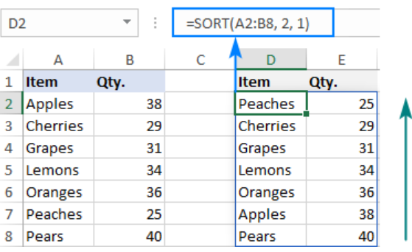
SORT - syntax
Array (required) - is an array of values or a range of cells to sort.
Sort_index (optional) – an integer that indicates which column or row to sort by.
Sort_order (optional) – defines the sort order. 1 or omitted (default) - ascending order, -1 - descending order.
By_col (optional) – a logical value that indicates the direction of sorting: FALSE or omitted (default) - sort by row, TRUE - sort by column.
=SORT(A2:B8;2;1)

Slide 8
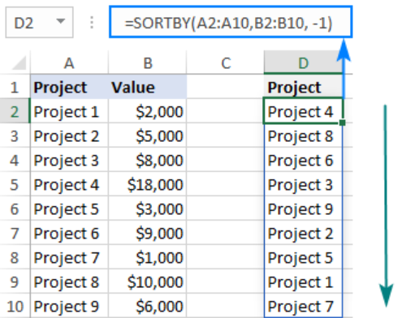
SORTBY - syntax
Array (required) - the range of cells or array of values to be sorted.
By_array1 (required) – the range or array to sort by.
Sort_order1 (optional) – the sorting order: 1 or omitted (default) – ascending, -1 - descending.
=SORTBY(A2:B10;B2:B10;-1)

Slide 9
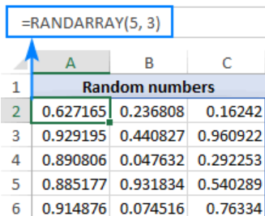
RANDARRAY - syntax
Rows (optional) – defines how many rows to fill. If omitted, defaults to 1 row.
Columns (optional) - defines how many columns to fill. If omitted, defaults to 1 column.
Min (optional) - the smallest random number to produce. If not specified, the default 0 value is used.
Max (optional) - the largest random number to create. If not specified, the default 1 value is used.
Whole_number (optional) - determines what kind of values to return: TRUE - whole numbers, FALSE or omitted (default) - decimal numbers.
=RANDARRAY(5;3)

Slide 10
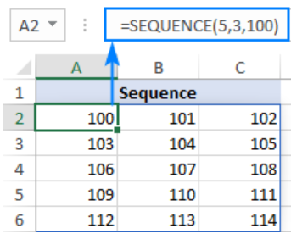
SEQUENCE - syntax
Rows (optional) - the number of rows to fill.
Columns (optional) - the number of columns to fill. If omitted, defaults to 1 column.
Start (optional) - the starting number in the sequence. If omitted, defaults to 1.
Step (optional) - the increment for each subsequent value in the sequence. It can be positive or negative.
=SEQUENCE(5;3;100)

Slide 11
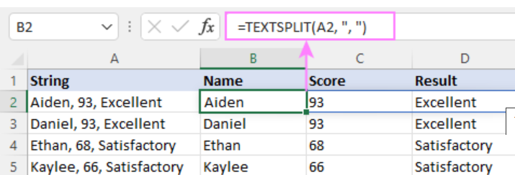
TExtsplit - syntax
Text (required) - the text to split. Can be supplied as a string or cell reference.
Col_delimiter (required) - a character(s) that indicates where to split the text across columns. If omitted, row_delimiter must be defined.
Row_delimiter (optional) - a character(s) that indicates where to split the text across rows.
Ignore_empty (optional) - specifies whether to ignore empty values or not: FALSE (default) - create empty cells for consecutive delimiters without a value in-between, TRUE - ignore empty values, i.e. don't create empty cells for two or more consecutive delimiters.
Match_mode (optional) - determines case-sensitivity for the delimiter. Enabled by default.
Pad_with (optional) - a value to use in place of missing values in two-dimensional arrays. The default is a #N/A error.
=TEXTSPLIT(A2; "; ")

Slide 12
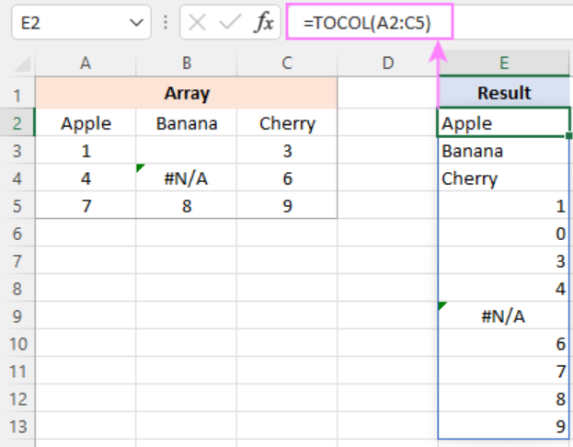
TOCOL - syntax
Array (required) - an array or range to transform into a column.
Ignore (optional) - defines whether to ignore blanks or/and errors.
Scan_by_column (optional) - determines whether to scan the array horizontally or vertically.
=TOCOL(A2:C5)

Slide 13
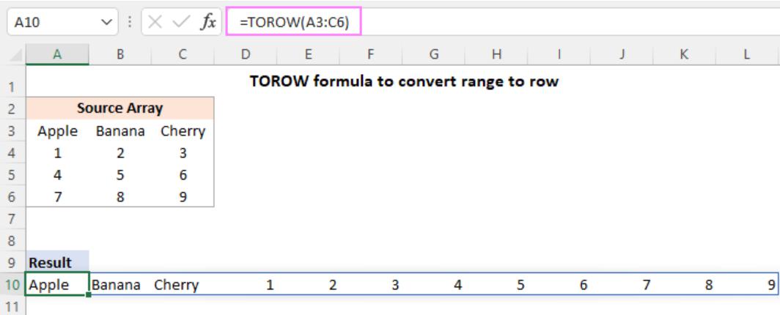
TOROW - syntax
Array (required) - an array or range to transform into a single row.
Ignore (optional) - determines whether to ignore blanks or/and errors.
Scan_by_column (optional) - defines how to scan the array.
=TOROW(A3:C6)

Slide 14
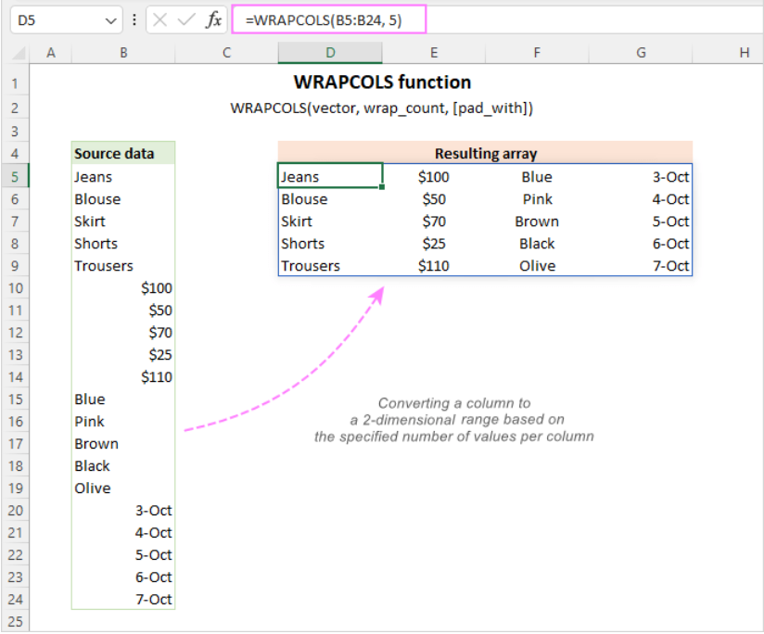
WRAPCOLS - syntax
Vector (required) - the source one-dimensional array or range.
Wrap_count (required) - the max number of values per column.
Pad_with (optional) - the value to pad with the last column if there are insufficient items to fill it. If omitted, the missing values will be padded with #N/A (default).
=WRAPCOLS(B5:B24;5)

Slide 15
WRAPROWS - syntax
Vector (required) - the source one-dimensional array or range.
Wrap_count (required) - the max number of values per row.
Pad_with (optional) - the value to pad with the last row if there are insufficient items to fill it. The default is #N/A.

Slide 16
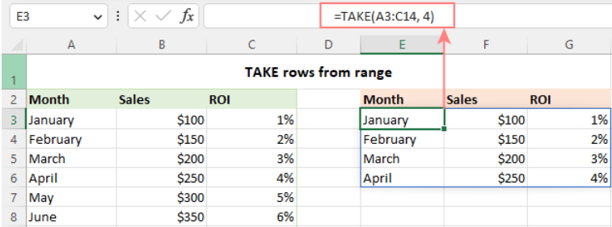
TAKE - syntax
Array (required) - the source array or range.
Rows (optional) - the number of rows to return. A positive value takes rows from the start of the array and a negative value from the end of the array. If omitted, columns must be set.
Columns (optional) - the number of columns to return. A positive integer takes columns from the start of the array and a negative integer from the end of the array.
=TAKE(A3:C14;4)

Slide 17
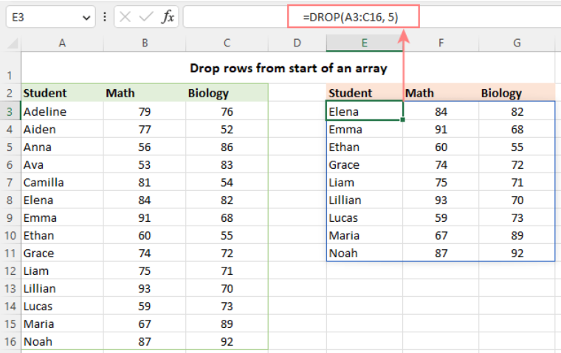
DROP - syntax
Array (required) - the source array or range.
Rows (optional) - the number of rows to drop. A positive value removes rows from the start of the array and a negative value from the end of the array.
Columns (optional) - the number of columns to drop. A positive integer excludes columns from the start of the array and a negative integer from the end of the array..
=DROP(A3:C16;5)

Slide 18
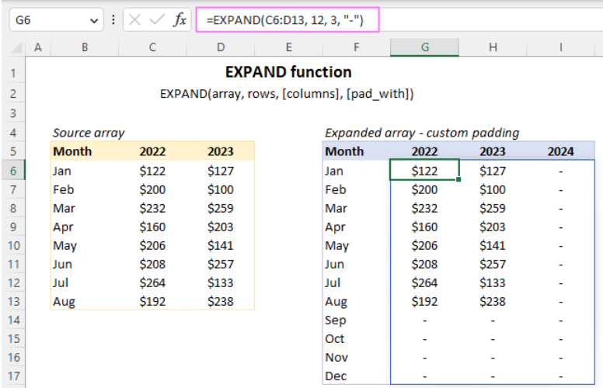
EXPAND - syntax
Array (required) - the original array.
Rows (optional) - the number of rows in the returned array. If omitted, new rows are not added, and the columns argument must be set.
Columns (optional) - the number of columns in the returned array.
Pad_with - the value to fill new cells with. If omitted, defaults to #N/A.
=EXPAND(C6:D13;12; 3;"-")

Slide 19
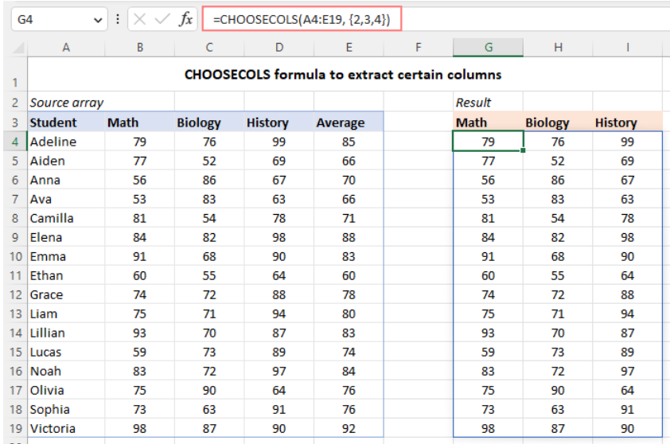
CHOOSECOLS - syntax
Array (required) - the source array or range.
Col_num1 (required) - an integer specifying the first column to return.
It is possible to set 253 columns.
=CHOOSECOLS(A4:E19;2;3;4)

Slide 20
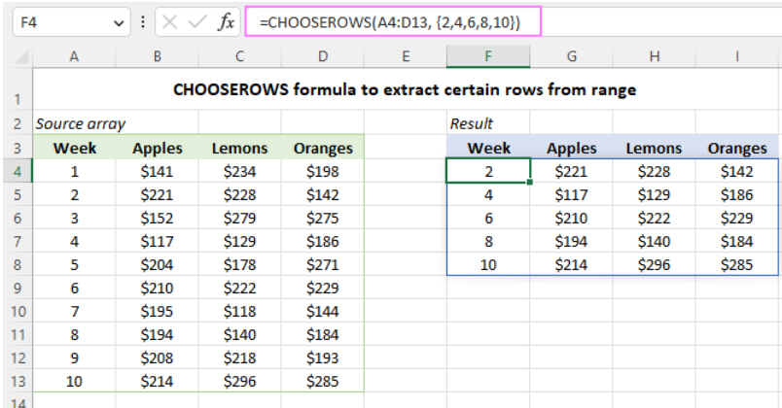
CHOOSEROWS - syntax
Array (required) - the source array.
Row_num1 (required) - an integer representing the numeric index of the first row to return.
It is possible to set 253 rows.
=CHOOSEROWS(A4:D13;2;4;6;8;10)

Slide 21
GROUPBY - syntax
Row_fields (required) - the range of values you want to group.
Values (required) - the values to aggregate.
Function (required) - the function to summarize the grouped data.
Field_headers [optional] - specifies whether your dataset has headers and whether you want to include them in the results. If omitted, headers are not shown
Total_depth [optional] - determines whether to show totals and subtotals. For subtotals, the row_fields argument must have at least 2 columns.
Sort_order [optional] - sorting by column index number. Numbers correspond to columns in row_fields left-to-right, followed by columns in values.
Filter_array [optional] - filtering out specific rows. Can be provided as a logical expression that produces a 1D array of Boolean values matching the length of the row_fields array.
=GROUPBY(B2:B32;C2:C32;SUM)

Slide 22
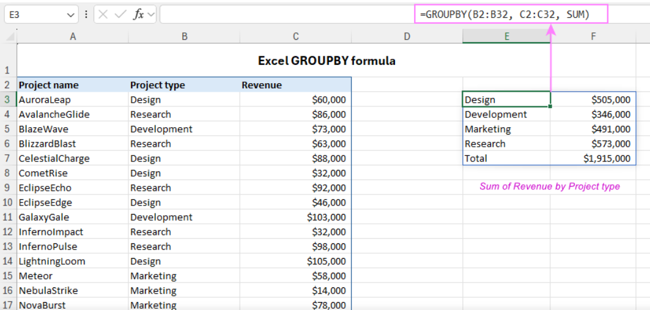

Slide 23
PIVOTBY - syntax
Row_fields (required) - a range of values to group in rows.
Col_fields (required) - a range of values to group in columns.
Values (required) - the values to aggregate.
Function (required) - the function to summarize the grouped data.
Field_headers [optional] - specifies whether to include headers in the results.
Row_total_depth [optional] - determines whether to show total rows.
Row_sort_order [optional] – a number indicating how to sort rows. Numbers correspond to columns in row_fields followed by the columns in values.
Col_total_depth [optional] - determines whether to include total columns.
Col_sort_order [optional] - a number indicating how to sort columns.
Filter_array [optional] - filtering out specific rows. Can be provided as a logical expression that generates a one-dimensional array of Boolean values matching the length of the row_fields and col_fields arrays.
Relative_to [optional] – when the PERCENTOF function is used for aggregation, specify how the calculation is performed relative to.
=PIVOTBY(B3:B32;C3:C32;D3:D32;SUM)

Slide 24
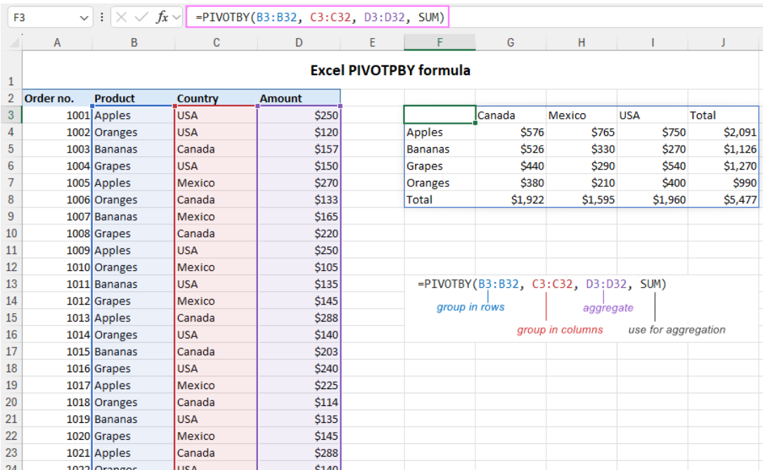

Slide 25
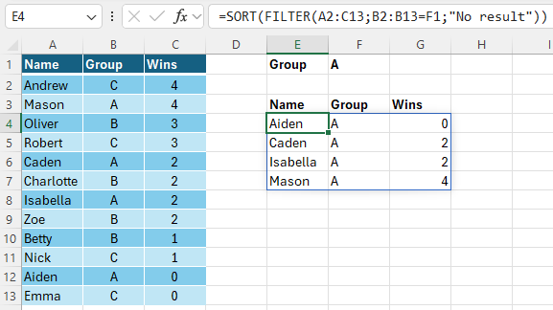
Combining several dynamic array functions in one formula

Slide 26
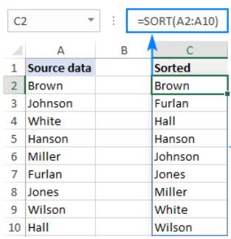
Spill range - one formula, multiple cells
One formula ➔ result in mulitple cells.
The spill range is a range of cells that contains the values returned by a dynamic array formula.
When any cell in the spill range is selected, the blue border appears to show that everything inside it is calculated by the formula in the top-left cell.
If you delete the formula in the first cell, all the results will be gone.

Slide 27
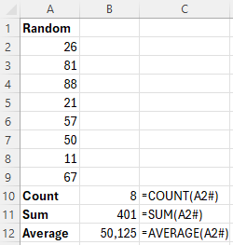
Spill range reference (# symbol)
To refer to an entire spill range returned by a dynamic array formula, put a hash tag or pound symbol (#) after the address of the upper-left cell in the range.

Slide 28
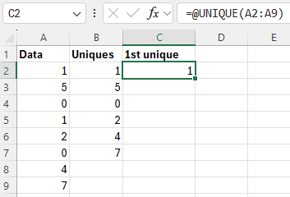
Implicit intersection and @ character
In dynamic array Excel, there is one more significant change in the formula language - the introduction of the @ character, known as the implicit intersection operator.
In Microsoft Excel, implicit intersection is a formula behavior that reduces many values to a single value. In old Excel, a cell could only contain a single value, so that was the default behavior and no special operator was needed for it.
In new Excel, all formulas are regarded as array formulas by default. The implicit intersection operator is used to prevent the array behavior if you do not want it in a specific formula.
In other words, if you wish the formula to return just one value, put @ before the function's name, and it will behave like a non-array formula in traditional Excel.

Slide 29
Advantages of Excel dynamic arrays
Simple and more powerful - dynamic arrays make it possible to create more powerful formulas in a much simpler way.
Native for all formulas – you do not need to bother which functions support arrays and which do not. If a formula can return multiple values, it will do so by default.
Nested dynamic array functions - To work out solutions for more complex tasks, you are free to combine new Excel dynamic array functions or use them together with old ones.
Relative and absolute references are less important - thanks to the "one formula, many values" approach, there is no need to lock ranges with the $ sign since, technically, the formula is in just one cell. So, for the most part, it does not really matter whether to use absolute, relative or mixed cell reference.

Slide 30
Limitations of dynamic arrays
Results cannot be sorted in the usual way - The spill range returned by a dynamic array formula cannot be sorted by using Excel's Sort feature. Any such attempt will result in the "You cannot change part of an array" error. To arrange the results from smallest to largest or vice versa, wrap your current formula in the SORT function.
Cannot delete any value in spill range - none of the values in a spill range can be deleted because of the same reason: you cannot change part of an array. This behavior is expected and logical.
Are not supported in Excel tables (Format as Table) – dynamic array formulas do not work from within Excel tables, only within regular ranges.
Do not work with Excel Power Query.

Slide 31
Thank you for your attention!
Notes:
https://www.ablebits.com/office-addins-blog/excel-dynamic-arrays-functions-formulas/

