Slide 1
Baťa's management

Slide 2
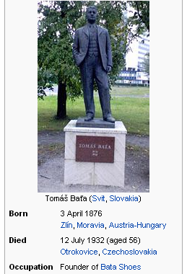
Tomáš Baťa
His contribution to the development of management lies in four management tools, which are:
preliminary calculations
operational planning
internal accounting
rewarding of employees

Slide 3
Preliminary calculations - gave an immediate overview of the calculated costs per unit of production:
monitoring of unit costs enabled an operational response to negative cost developments and rational cost reductions,
each center had calculated the cost of the part of the footwear it produced.
Operational planning - the weekly operational plan was divided into detailed day plans:
production had to be comprehensively provided by material, energy, people,
the purchasing department provided the inputs, it was responsible not only for the quantity but also the quality of the purchased raw materials,
Supply managers were sanctioned for expensive purchases.

Slide 4
Internal accounting - an important control tool
find out the real costs and compare them with preliminary calculations,
internal accounting information was used by managers, heads of centers and foremen,
They were evaluated by accountants and managers at regular Saturday conferences,
on Saturdays, the differences between the centers and the business units also leveled off.
Remuneration of employees - depends on performance, resp. achieved results:
every worker knew the amount of his earnings on a daily basis,
Premiums - share of profit after meeting the criteria - were also granted in addition to the tariff wage,
a minimum wage has also been set,
each employee had his / her personal account, to which he / she was credited with a weekly profit share,
a deduction for poor quality work was also deducted from the personal account.

Slide 5
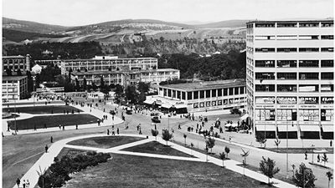
Managers had fixed monthly salaries.
Once a year employees were comprehensive evaluated according to the following criteria:
employee 's relationship with the company
character traits
performance
relationship with other employees

Slide 6
The shoe company was founded by the Baťa siblings on September 21, 1894.
The shoemaking tradition was developed at the beginning of the 20th century, which made Zlín an important Central European industrial city and shoemaking center.
Baťa's plants won huge orders during the First World War.
Millions of shoes went to the front on the feet of Austro-Hungarian soldiers.
In 1918, more than 4,000 employees worked in the Zlín factories.
The company overcame the post-war crisis by halving prices, thus dominating the Czechoslovak market.
On the outskirts of Zlín, a large complex with state-of-the-art machinery has grown, and the rubber, chemical and textile industries have also developed.

Slide 7
"All the blessings of my life began that day. By doing all the work, I found ways that led to material savings and simplification of work
... I carried raw materials on my back from the midnight train in Otrokovice station 10 km to Zlín
... I bought the material and cut it all by myself...I instructed workers, inspect the quality of product, pay them and do all the financial documentation by myself too.

Slide 8
Tomáš Baťa
Shoemaking family (in Zlín from the 17th century)
at 10 ymoved to Uh. Hradiště and transfer to local school
At 12 shoemaker's apprentices with his father
At 14 worked for Färber in Prostejov
The first business failure in Vienna
Business traveler in father's company
In 1894, he and his siblings were paid from a family business, and they founded a shoemaking trade in Zlín under the the eldest Antonín.
Wallachian footwear, 50 employees, sale of products of other tradesmen
They introduced fixed working hours and a weekly wage
In 1985, financial problems (bills of exchange, checks) fixed by 800 gold mom inheritances
After Antonín's departure for the war, Tomáš took over the company and the debts ... he got rid of them by the summer of 1896

Slide 9
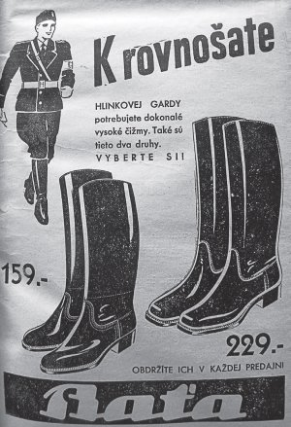
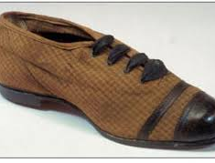
The Viennese company Kodish goes bankrupt and with it the company Baťa senior (bills of exchange), Tomáš settles family debts by selling "Baťovky"
Turn of the century: new machines, construction of buildings, 60 workers, factory in Pršná, death of Antonín
1904: departure to NY, Boston and Line (200 shoe factories), 3 expatriates - new approaches to management, new technologies, increasing production productivity
1908 death of Antonín, published by Anna, Tomáš at the head of T. & A. Baťa,
Serial construction, first export, fines for poor work, reluctance of unions,

Slide 10
1912 Wedding-son-severe car accident
1914 St. war: mobilization, lack of work, order from the army and the creation of the Zlín supply consortium (work in the factory delayed the call order)
Boom during the war: strike, wage cuts, layoffs, departure of prisoners of war, creation of staff accounts and their control.
20s crisis, 50% sale, 40% wage reduction replaced by 50% discount on food in corporate stores - export expansion (112 stores)
1923- Baťa mayor of Zlín, 1925_5200 employees, the total turnover of the company Baťa in the years 1926-1928 reached 1.9 billion crowns

Slide 11
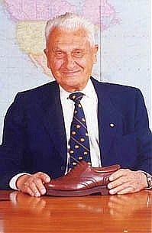
"Baťa support fund" from employees' fines - support for failing self-employed people,
staff allowances, social assistance, construction of family houses, boarding schools, hospitals, etc.,
accommodation for employees and their families - family houses (there were 718 of them until 1928), dormitories were set up for singles,
building schools - craft and business learning, higher industrial schools, business academies, language schools, various training courses, etc. (Baťa's school of work -1925- Tomáš's son also graduated),
employees' private lives were closely monitored (cigarette and alcohol bans), home visits,
In 1931, the family business turned into a joint stock company and subsidiaries began to emerge around the world,
own factories in Germany, England, the Netherlands, Poland, France, Switzerland, Yugoslavia and India. Dozens of production and trade companies in ČSR and worldvide.

Slide 12
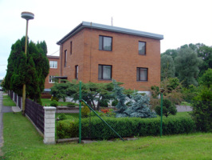
BAŤA TODAY…
It serves 1 million customers a day
It employs more than 40,000 people
It operates 4,600 stores
It manages sales in more than fifty countries
It operates 40 production plants in 26 countries
4 BUSINESS UNITS OF BAŤA
Bata Europe, Lausanne
Bata Asia Pacific-Africa, Singapore
Bata Latin America, Mexico
Bata North America, Toronto

Slide 13
Thank you for your attention.

