Slide 1
Data validation and database
doc. Ing. Marcela Hallová, PhD.

Slide 2
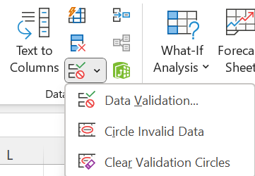
Data validation
Use data validation to restrict the type of data or the values that users enter to a cell.
One of the most common data validation uses is to create a drop-down list.

Slide 3
Use of data validation
Select the cell(s) you want to create a rule for.
Select Data >Data Validation.
On the Settings tab, under Allow, select an option:
  Whole Number - to restrict the cell to accept only whole numbers.
  Decimal - to restrict the cell to accept only decimal numbers.
  List - to pick data from the drop-down list.
  Date - to restrict the cell to accept only date.
  Time - to restrict the cell to accept only time.
  Text Length - to restrict the length of the text.
  Custom – for custom formula.

Slide 4
Use of data validation – cont.
Under Data, select a condition.
Set the other required values based on what you chose for Allow and Data.
Select the Input Message tab and customize a message users will see when entering data.
Select the Show input message when cell is selected checkbox to display the message when the user selects or hovers over the selected cell(s).
Select the Error Alert tab to customize the error message and to choose a Style.
Select OK.

Slide 5
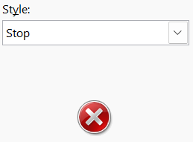
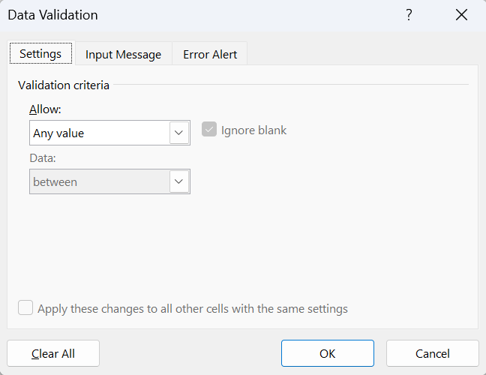
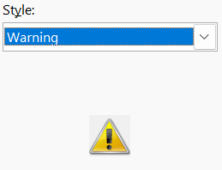
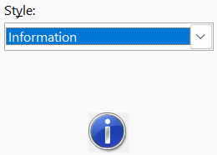

Slide 6
What is database?
A database is a collection of data that has its own structure.
Thanks to this structure, users can obtain the necessary information from the database with simple as well as more complex tools.
In Excel, these tools include, for example, functions, filtering, pivot tables, etc.

Slide 7
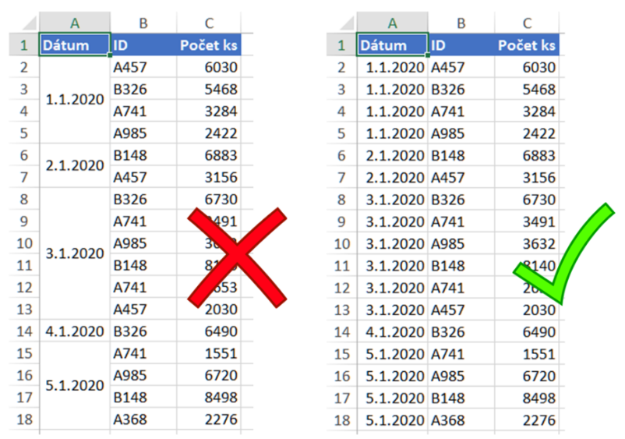
Rules and recommendations for creating databases
A row database is the best: one row = one record.
Do not merge cells!

Slide 8
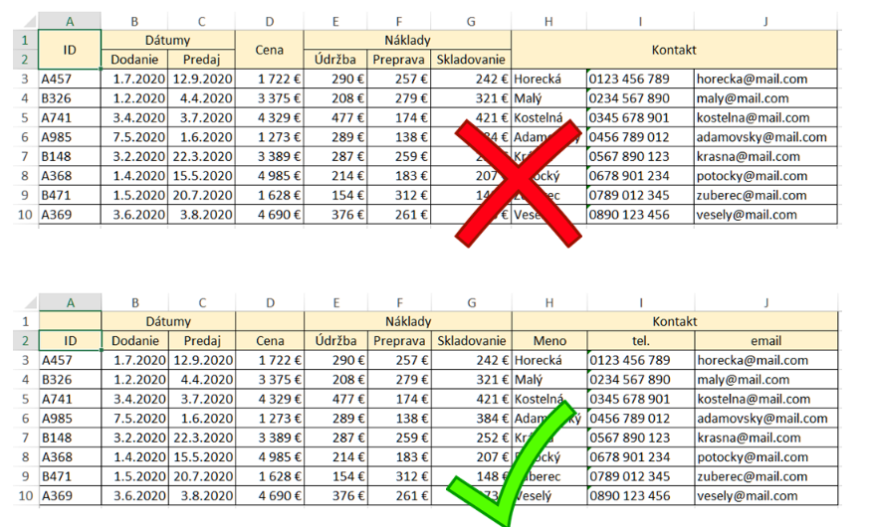
Rules and recommendations for creating databases
Header in one row: One row should mainly be the one that is directly above the data.

Slide 9
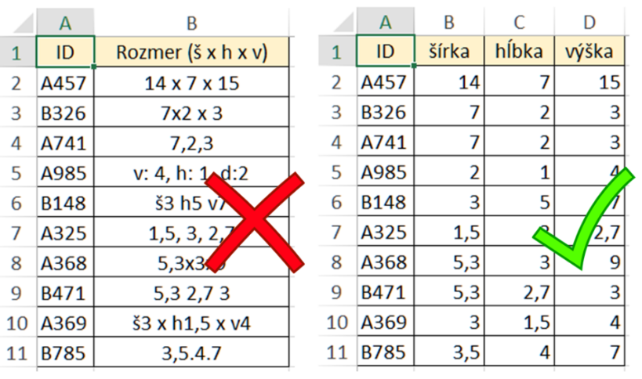
Rules and recommendations for creating databases
It is always easier to merge than to split:
if there is any data that can be split into multiple columns, then split it into multiple columns.

Slide 10
Rules and recommendations for creating databases
combine letters and numbers in the codes
if you really want to use only numbers, don't start with zero
try to invent a puzzle, e.g. room code H0415M means it is a meeting room in the main building on the 4th floor with door number 15
Use codes: even if there are few items, mark them with a code
Notes:
Najhoršie je, keď je to isté napísané desiatimi rôznymi spôsobmi. Napríklad použitie funkcie VLOOKUP je nemožné, pretože „priemyselný ventilátor“ nie je to isté ako „priem. ventilátor“, alebo „priemyselny ventilator“, alebo „priem.vent.“

Slide 11
Rules and recommendations for creating databases
One row = one item for the entire period
One row = one item in one time period
One row = one time period
It is better when the database grows in height, not in width: think about the structure - what will be in the rows and what will be in the columns?

Slide 12
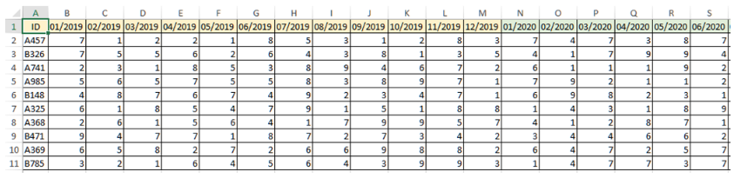
A. One row = one item for the entire period
This database will grow every month. Such an overview is useful if we need an overview of a given item in one line.

Slide 13
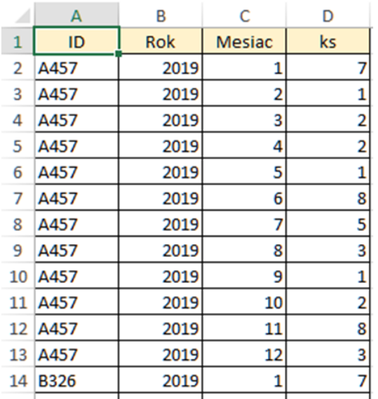
B. One row = one item in one time period
The disadvantage is that it can grow quickly and over time will have a lot of rows. But the old years can be moved to the archive if we no longer need them for analysis.

Slide 14
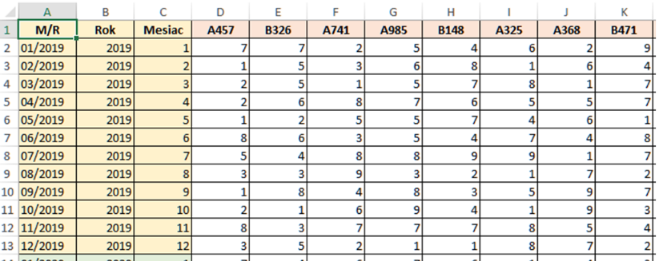
C. One row = one time period
Such a structure is suitable when you need to compare periods. But it will be more difficult to compare individual items with each other, because they are in columns.

Slide 15
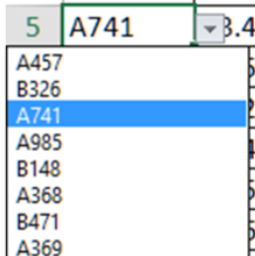
Rules and recommendations for creating databases
The fuse can be a drop-down list:
uniformity of entries will be ensured
saves time for the user
error prevention
Uniformity in records: make sure you write the same things the same way, especially the text ones.

Slide 16
Rules and recommendations for creating databases
Think big: even if you have few records, work with them as if there were 10,000 of them.
The database may grow in time.
At the very beginning, try to automate, e.g. using formulas and functions, pivot tables.

Slide 17
Tips for routine data recording
really only use comments/notes for very little essential information
if there are any documents, pictures with the records, create a separate column
learn the keyboard shortcuts for movement and selection: Ctrl+Arrow and Ctrl+Shift+Arrow

Slide 18
Useful keyboard shortcuts
Ctrl + arrow >> jump to the last filled cell in the direction of the arrow (the first empty cell will stop you)
Ctrl + Shift + arrow >> vyznačenie od aktuálnej pozície po poslednú vyplnenú bunku v smere šípky (prvá prázdna bunky vás zastaví)
Home >> jump to the first cell in the active row
Ctrl + Home >> jump to the beginning of the sheet to cell A1 (if you have set panes, it is the first cell below the pane/next to the pane)
Ctrl + A in a filled cell >> selection of the surrounding range of cells (over the entire empty column and row)
Ctrl + A in an empty cell or Ctrl + A twice >> selection of the entire sheet

Slide 19
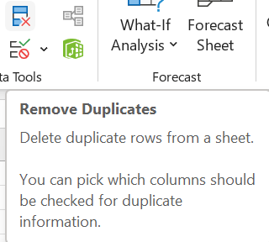
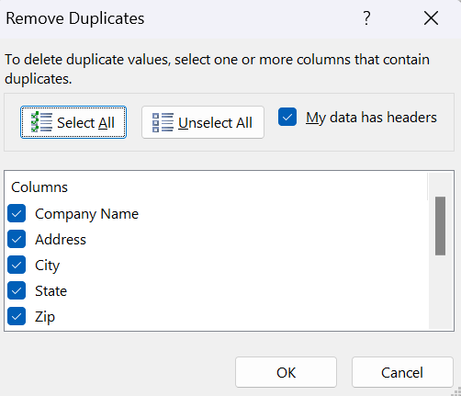
Duplicate removal
Tool – Remove duplicates
  This tool removes rows that are repeated and tells you how many have been removed. With its help, you won't find out which ones are repeated.
  Suitable for use when you need to quickly clean the database of duplicate records and you don't care which ones they are.

Slide 20
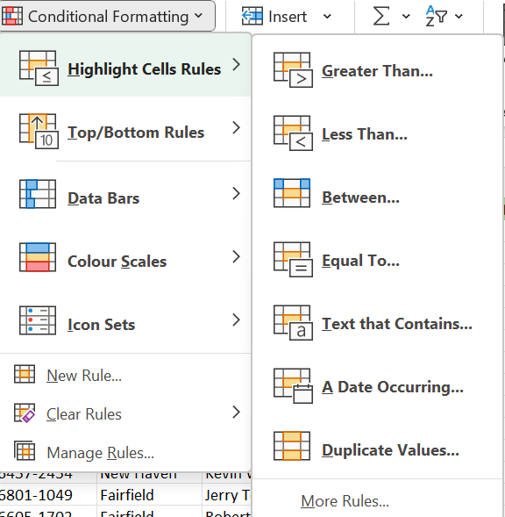
Marking duplicates
Conditional formatting
  Using conditional formatting, you can color duplicate data. Suitable to use when you want to know which ones are repeated.
  However, it is necessary to have some column that should contain unique items, for example, identification number, code, etc.

Slide 21
Data sorting
Sorting data is an integral part of data analysis.
Sorting enables quick visualization and better understanding of data, organization and search of required data, and ultimately making more effective decisions.
We can sort data by text (A to Z or Z to A), numbers (smallest to largest or largest to smallest), or date and time (oldest to newest or newest to oldest) in one or more columns.
We can also sort according to our own list that we have created.
You can also sort by format, including cell color, font color, or icon set.

Slide 22
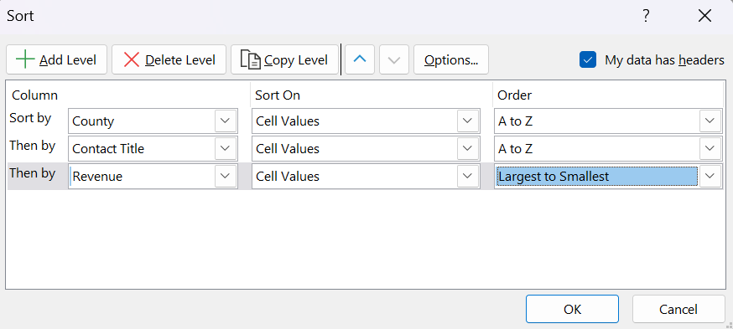
Data sorting – cont.
To sort by a single column, just click on one cell in that column and use either the right mouse button and select Sort or Tools on the Home tab in the Editing group or Tools on the Data tab in the Sort and Filter group.
You can also sort by more than one column.

Slide 23
Data filtering in the database
Filtering means that Excel temporarily hides records (rows) that do not meet the criteria we specified.
Excel​​ offers 5 types of filters​​ Automatic filter​​, Advanced filter, Quick filter (Slicer), Time line and filtering via the =FILTER() function.

Slide 24

Automatic filter
The automatic filter​​ is the simplest and also the most used method of filtering by most users.
With the automatic filter, there are 3 filtering options:
  text
  number
  date

Slide 25

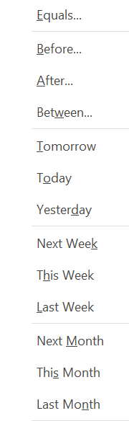
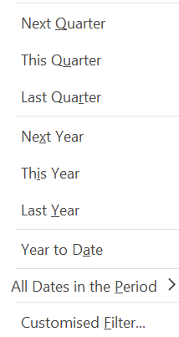

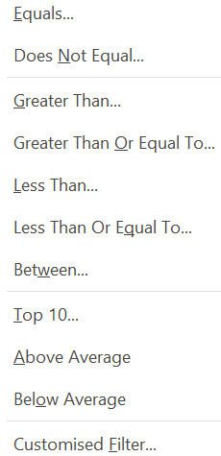

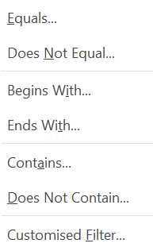

Slide 26

Advanced filter
The advanced filter is an extended version of the automatic filter.
Differences between automatic filter and advanced filter:
  Although the automatic data filter will filter the existing data set, we can also extract the data set to another location using the advanced filter.
  Advanced filter allows you to use complex criteria - more than two criteria within one column.
  The advanced filter can also be used to extract unique records from the data.

Slide 27
Advanced filter – cont.
Before use, a criteria table is created - a table outside the main database.
The criteria table header must contain identical names from the main table.
Criteria entered in one line - apply simultaneously.
Criteria specified one line below - one or the other criteria applies.
The criteria are not case sensitive.

Slide 28
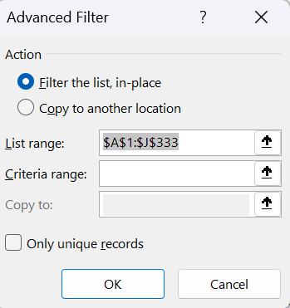
Advanced filter – cont.
Method of use:
  Click into the main database in any cell.
  On the Data tab, in the Sort and filter group, select Advanced.
  In the dialog window, set the conditions.

Slide 29

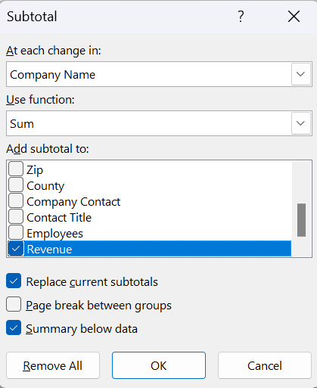
Tool Subtotal
Using the Subtotal tool, we can automatically calculate subtotals and grand totals in a table for a column.
Important condition - row in the dialog box At each change in a column - the used column must be sorted.
We then select the desired function from the list and check the column in which the result should be displayed.

Slide 30
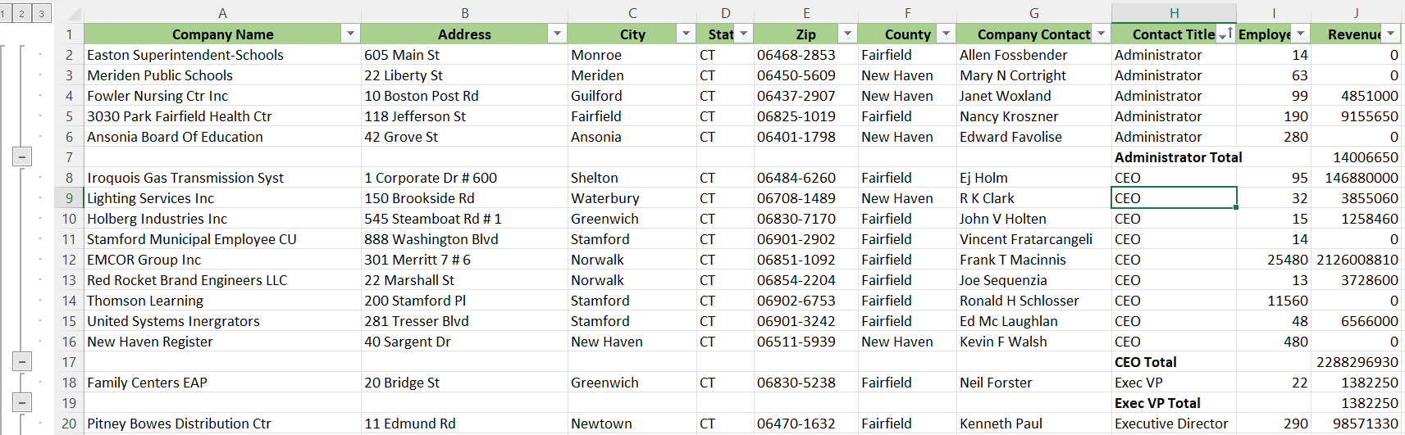

Slide 31
Conditional formatting
Conditional formatting​​ in Excel is a very useful tool that can be used to format cells when they meet a condition we specify.
This is where the name itself came from -​​ Conditional formatting, in other words formatting (i.e. setting certain colors and properties to cells and fonts) based on a condition.
You can format the color of the text, shading, bordering or the cell format itself - euros, number of decimal places, etc..

Slide 32


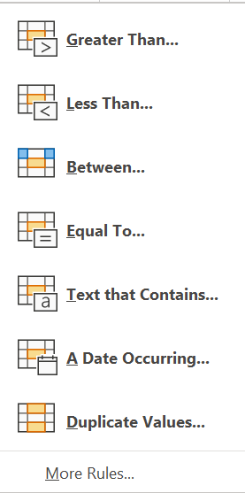
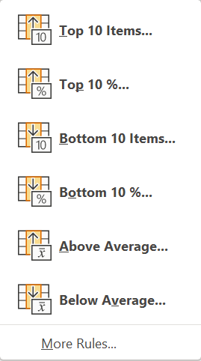
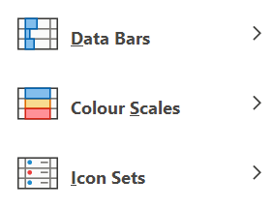

Slide 33
Conditional formatting - method
Highlight the area / cells where the values that we want to format are located.
Click on the Conditional Formatting tool on the Home tab.
Select the option we need from the menu.
Set the condition and choose the format.
Confirm with the OK button.

Slide 34
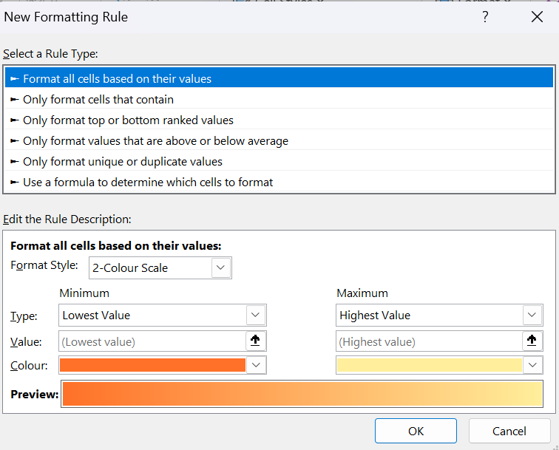

Slide 35
Thank you for your attention!

