Slide 1
Pivot tables
Doc. Ing. Marcela hallová, phd.

Slide 2
Pivot table
Pivot table is essentially a dynamic summary report generated from a database.
A PivotTable can help transform endless rows and columns of numbers into a meaningful presentation of the data.
The most powerful aspect of a PivotTable is its interactivity.
After you create a PivotTable, you can rearrange the information in almost any way imaginable and even insert special formulas that perform new calculations.

Slide 3
Why Pivot?
Pivot, as a verb, means to rotate or revolve.
If you think of your data as a physical object, a PivotTable lets you rotate the data summary and look at it from different angles or perspectives.
A PivotTable allows you to move fields around easily, nest fields within each other, and even create ad hoc groups of items.
A PivotTable invites experimentation, so feel free to rotate and manipulate the PivotTable until you’re satisfied.

Slide 4
Questions that may be of interest to the bank’s management:
What is the daily total new deposit amount for each branch?
Which day of the week accounts for the most deposits?
How many accounts were opened at each branch, broken down by account type?
How much money was used to open accounts?
What types of accounts do tellers open most often?
In which branch do tellers open the most checking accounts for new customers?

Slide 5
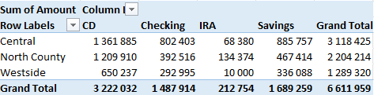
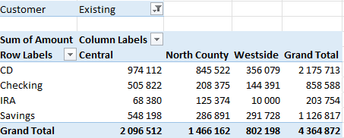
Pivot table examples

Slide 6
Data appropriate for a PivotTable
Fields in a table consist of two types of information:
Data - contains a value or data to be summarized. For the bank account example, the Amount field is a data field.
Category - describes the data. For the bank account data, the Date, Weekday, AcctType, OpenedBy, Branch, and Customer fields are category fields because they describe the data in the Amount field.
A database table that’s appropriate for a PivotTable is said to be “normalized.” In other words, each record (or row) contains information that describes the data.

Slide 7
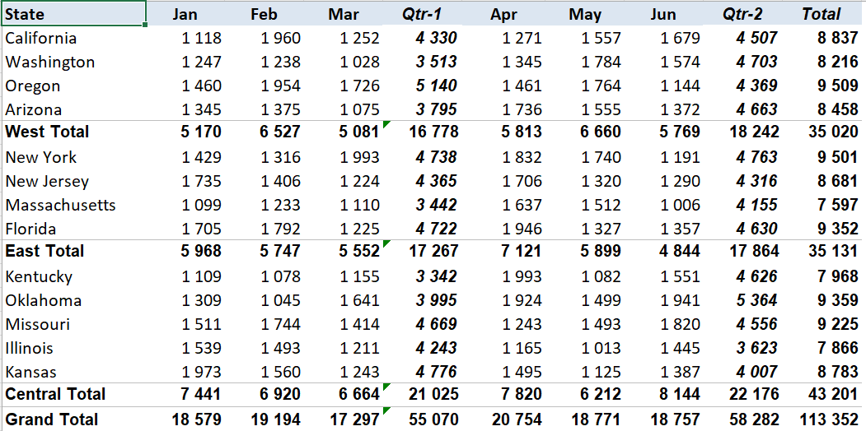
Range not appropriate for a PivotTable.

Slide 8
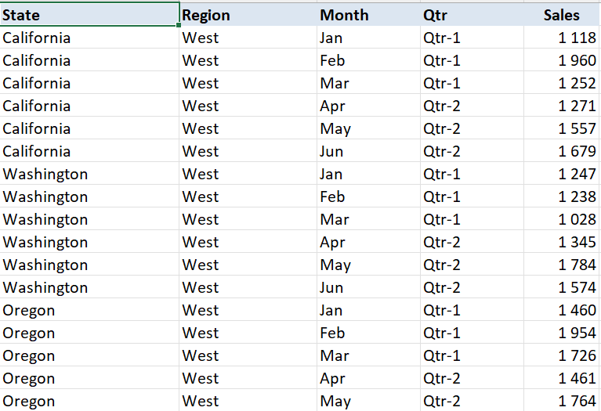
This range contains normalized data and is appropriate for a PivotTable.

Slide 9
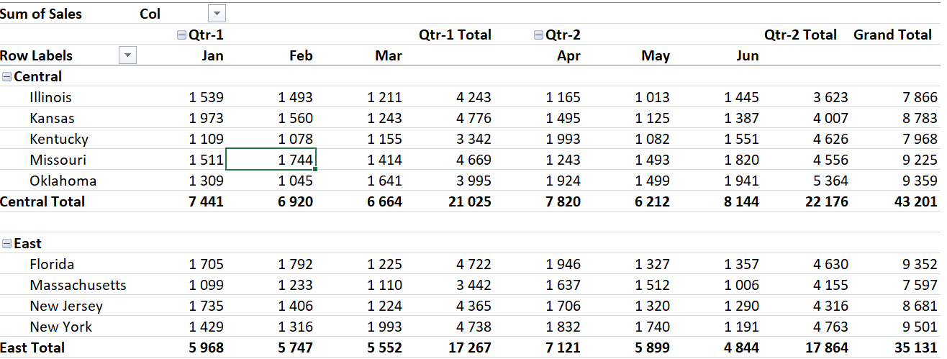
A PivotTable created from normalized data

Slide 10
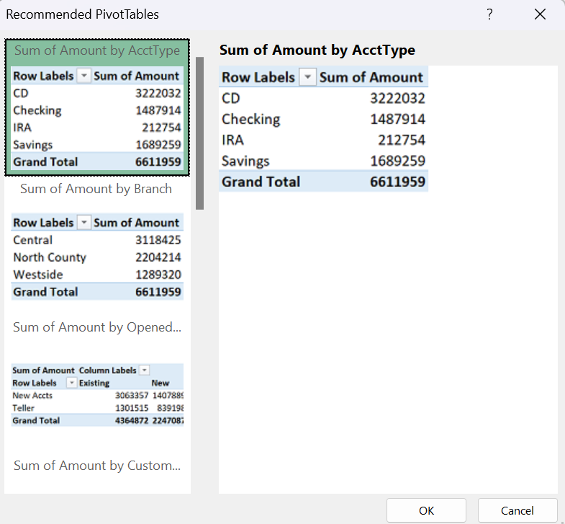
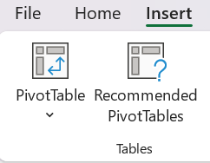
Creating a PivotTable Automatically

Slide 11
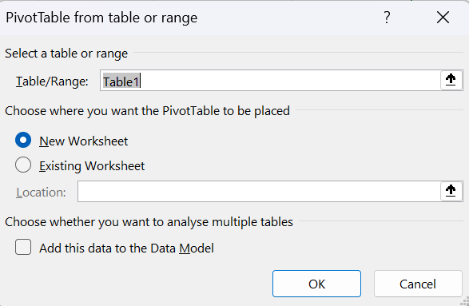
Creating a PivotTable Manually
1) Specifying the data - If your data is in a worksheet range, select any cell in that range and then choose Insert ➪Tables ➪ PivotTable.

Slide 12
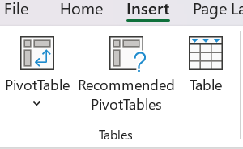
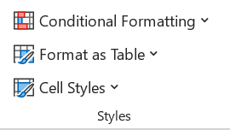
Special tip
If you’re creating a PivotTable from data in a worksheet, it’s a good idea first to create a table for the range.
Choose Insert ➪ Tables ➪ Table.
Then, if you expand the table by adding new rows of data, the PivotTable will automatically adjust to cover the whole table without the need to indicate the new data range manually.

Slide 13
Creating a PivotTable Manually
2) Specifying the location for the PivotTable

Slide 14
Creating a PivotTable Manually
3) Laying out the PivotTable:
Drag the field names (at the top of the PivotTable Fields task pane) to one of the four boxes at the bottom of the task pane.
Place a check mark next to the item at the top of the PivotTable Fields task pane. Excel places the field into one of the four boxes at the bottom. You can drag it to a different box, if necessary.
Right-click a field name at the top of the PivotTable Fields task pane, and choose its location from the shortcut menu.

Slide 15
PivotTable Terminology
Column labels - A field that has a column orientation in the PivotTable. Each item in the field occupies a column. You can have nested column fields.
Grand totals - A row or column that displays totals for all cells in a row or column in a PivotTable. You can specify that grand totals be calculated for rows, columns, both, or neither.
Group - A collection of items treated as a single item. You can group items manually or automatically.
Item - An element in a field that appears as a row or column header in a PivotTable.
Refresh - Recalculates the PivotTable after making changes to the source data.
Row labels - A field that has a row orientation in the PivotTable. Each item in the field occupies a row. You can have nested row fields.
Source data - The data used to create a PivotTable. It can reside in a worksheet or an external database.

Slide 16
PivotTable Terminology – cont.
Row labels - A field that has a row orientation in the PivotTable. Each item in the field occupies a row. You can have nested row fields.
Source data - The data used to create a PivotTable. It can reside in a worksheet or an external database.
Subtotals - A row or column that displays subtotals for detail cells in a row or column in a PivotTable. label for a subtotal is the Item name that’s being totaled and the word Total.
Table Filter - A field that has a page orientation in the PivotTable, which is used to limit what data is summarized. You can display one item, multiple items, or all items in a page field at one time.
Values area - The cells in a PivotTable that contain the summary data. Excel offers several ways to summarize the data (sum, average, count, and so on).

Slide 17
Formatting the PivotTable
It is possible to apply any of several built-in styles to a PivotTable. PivotTable Tools ➪ Design ➪ PivotTable Styles
We can use the controls from the PivotTable ➪ Design ➪ Layout group to control various elements in the PivotTable. You can adjust any of the following elements:
Subtotals Hide subtotal, or choose where to display them (above or below the data).
Grand Totals Choose which types, if any, to display.
Report Layout Choose from three different layout styles (compact, outline, or tabular).
You can also choose to hide repeating labels.
Blank Row Add a blank row between items to improve readability.
The PivotTable Tools ➪ Analyze ➪ Show group contains additional options that affect the appearance of your PivotTable.
Still more PivotTable options are available from the PivotTable Options dialog box. To display this dialog box, choose PivotTable Tools ➪ Analyze ➪ PivotTable ➪ Options, or rightclick any cell in the PivotTable and choose PivotTable Options from the shortcut menu.

Slide 18
PivotTable Calculations
PivotTable data is most frequently summarized using a sum.
However, you can display your data using a number of different summary techniques, specified in the Value Field Settings dialog box.
The quickest way to display this dialog box is to right-click any value in the PivotTable and choose Value Field Settings from the shortcut menu.
This dialog box has two tabs: Summarize Values By and Show Values As.

Slide 19
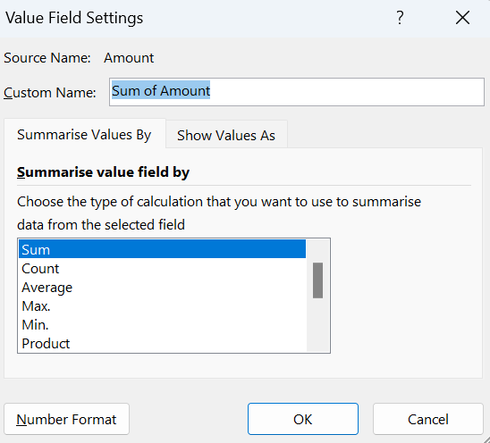
PivotTable Calculations – cont.
Use the Summarize Values By tab to select a different summary function. Your choices are Sum, Count, Average, Max, Min, Product, Count Numbers, StdDev, StdDevp, Var, and Varp.
To display your values in a different form, use the drop-down control on the Show Values As tab. You have many options from which to choose, including as a percentage of the total or subtotal.

Slide 20
Modifying the PivotTable
To remove a field from the PivotTable, select it in the bottom part of the PivotTable Fields task pane and then drag it away.
If an area has more than one field, you can change the order in which the fields are listed by dragging the field names. Doing so determines how nesting occurs, and it affects the appearance of the PivotTable.
To remove a field temporarily from the PivotTable, remove the check mark from the field name in the top part of the PivotTable Fields task pane. The PivotTable is redisplayed without that field. Place the check mark back on the field name, and it appears in its previous section.
If you add a field to the Filters section, the field items appear in a drop-down list, which allows you to filter the displayed data by one or more items.

Slide 21
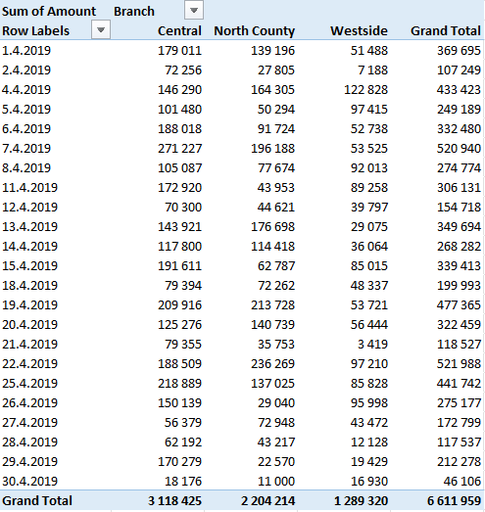
What is the daily total new deposit amount for each branch?

Slide 22
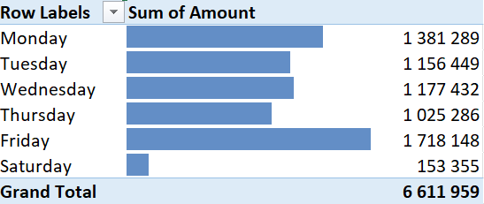
Which day of the week accounts for the most deposits?

Slide 23
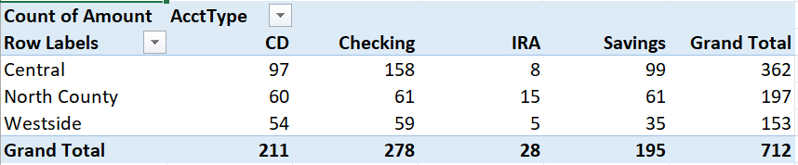
How many accounts were opened at each branch, broken down by account type?

Slide 24
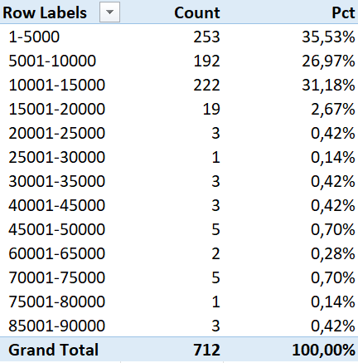
How much money was used to open the accounts?

Slide 25
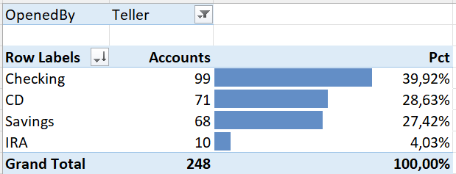
What types of accounts do tellers open most often?

Slide 26
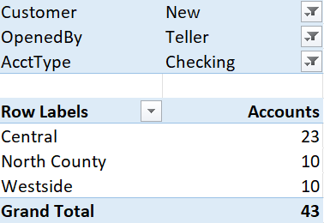
In which branch do tellers open the most checking accounts for new customers?

Slide 27
Thank you for your attention!

