Slide 1
Data models, sparklines, charts, goalseek, scenarios
Doc. Ing. Marcela Hallová, PhD.

Slide 2
Data Model
Data model brings more power to PivotTables.
With the data model, we can use multiple tables of data in a single PivotTable.
We’ll need to create one or more “table relationships” so that the data can be tied together.
A workbook can have only one data model.
You can’t have one model for one PivotTable and another model for another PivotTable within the same workbook.
Notes:
Figure 30.29 shows parts of three tables that are in a single workbook. (Each table is in its own worksheet and is shown in a separate window.) The tables are named Orders, Customers, and Regions. The Orders table contains information about product orders. The Customers table contains information about the company’s customers. The Regions table contains a region identifier for each state. Notice that the Orders and Customers tables have a CustomerID column in common, and the Customers and Regions tables have a State column in common. The common columns will be used to form relationships among the tables. These relationships are “one-to-many.” For every row in the Orders table, there is exactly one corresponding row in the Customers table, and that row is determined by the CustomerID column. For any row in the Customers table, there can be many rows in the Orders table. The Orders table is the many, and the Customers table is the one in the oneto-many relationship. Similarly, for every row in the Customers table, there is exactly one corresponding row in the Regions table, and that row is determined by the State column. And for any row in Regions, there can be many matching rows in Customers.

Slide 3
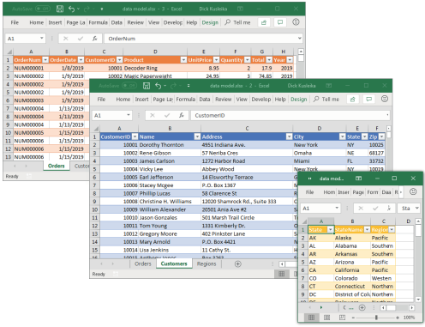
These three tables will be used for a PivotTable, using the data model.
Notes:
A PivotTable created using the data model has some restrictions, as opposed to a PivotTable created from a single table. Most notably, you can’t group items or create calculated fields or calculated items.

Slide 4
Start by creating a PivotTable (in a new worksheet) from the Orders table. Follow these steps:
Select any cell within the Orders table and choose Insert ➪ Tables ➪ PivotTable. The Create PivotTable dialog box appears.
Select the Add This Data to the Data Model check box and click OK. Notice that the PivotTable Fields task pane is a bit different when you’re working with the data model. The task pane contains two tabs: Active and All. The Active tab lists only the Orders table. The All tab lists all of the tables in the workbook.
Choose Data ➪ Data Tools ➪ Relationships and click the New button. This shows the Manage Relationships dialog box. It’s empty because we haven’t set up our relationships yet.
Relate the Orders table to the Customers table. Select Data Model Table: Orders and CustomerID in the top section and Worksheet Table: Customers and CustomerID in the bottom section.
Notes:
For this example, the goal is to summarize sales by state, by region, and by year. Notice that the sales and date information is in the Orders table, the state information is in the Customers table, and the region names are in the Regions table. Therefore, all three tables will be used to generate this PivotTable.
You made the Orders table part of the data model when you checked the box creating the PivotTable. The other two tables are not currently part of the data model.

Slide 5
Start by creating a PivotTable (in a new worksheet) from the Orders table. Follow these steps: cont.
Relate the Customers table to the Regions table. Click the New button in the Manage Relationships dialog box and create a relationship similar to how you did it in the previous step. Notice how the Customers table is now identified as being part of the data model. When you created the relationship in the previous step, you added the Customers table to the data model.
Build the PivotTable. After you’ve closed the Manage Relationships dialog box, you’re ready to build the PivotTable. Move the Region and StateName fields to the Rows area, move the Year field to the Columns area, and move the Total field to the Values area.

Slide 6
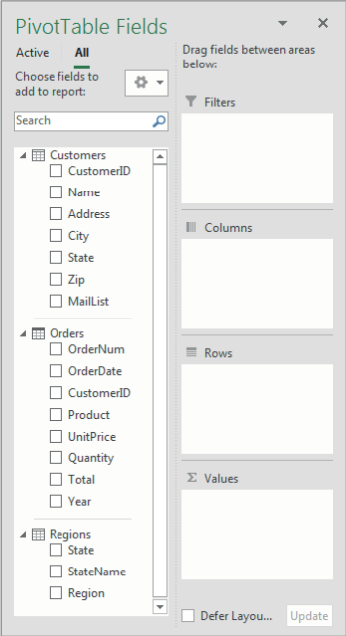
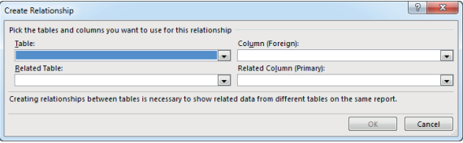
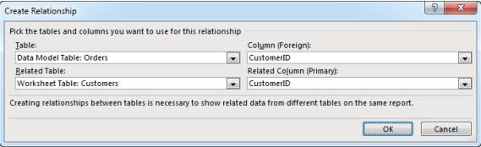
The PivotTable Fields task pane for a data model

Slide 7
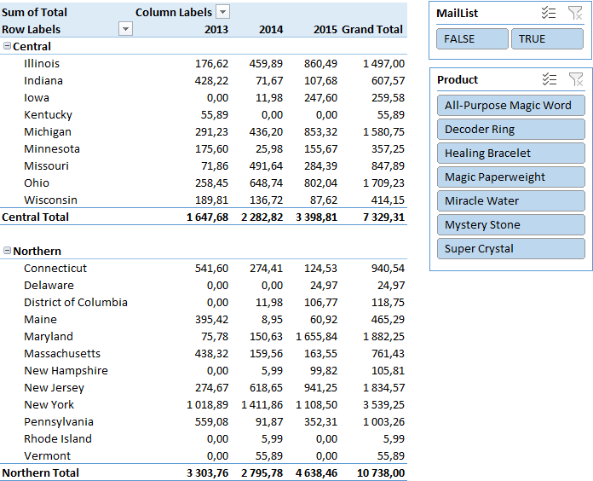
A PivotTable based on the data model

Slide 8
Sparkline Graphics
small chart that’s displayed in a single cell,
allows you to spot time-based trends or variations quickly in data,
Because they’re so compact, Sparklines are almost always used in a group.
Although Sparklines look like miniature charts (and can sometimes take the place of a chart), this feature is completely separate from the charting feature.
A Sparkline is displayed inside a cell and displays only one series of data.

Slide 9
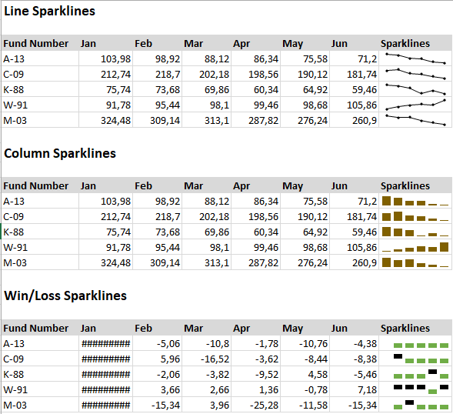

Slide 10
Excel charts
A chart is a visual representation of numeric values.
Charts (also known as graphs) have been an integral part of spreadsheets since the early days of Lotus 1-2-3.
Displaying data in a well-conceived chart can make your numbers more understandable.
Because a chart presents a picture, charts are particularly useful for summarizing a series of numbers.

Slide 11
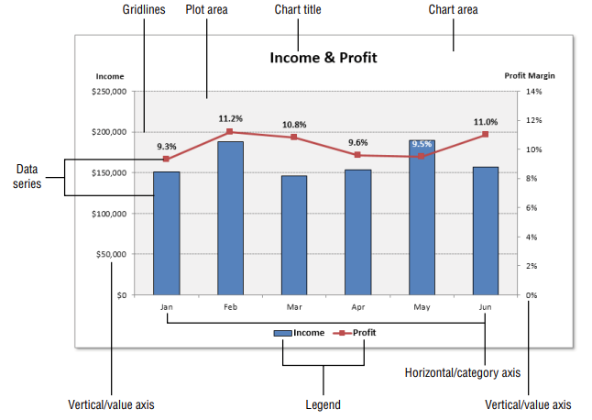
Parts of a chart

Slide 12
Chart limitations
Item | Limitation
Charts in a worksheet | Limited by available memory
Worksheets referred to by a chart | 255
Data series in a chart | 255
Data points in a data series | 32 000
Data points in a data series (3-D charts | 4 000
Total data points in a chart | 256 000

Slide 13
Creating the chart
Select the data you want to use in the chart. Make sure you select the column headers if the data has them.
Click the Insert tab and then click a Chart icon in the Charts group. The icon expands into a gallery list that shows chart subtypes for the selected chart type.
Click a Chart subtype, and Excel then creates the chart of the specified type.

Slide 14
Column charts
Probably the most common chart type is the column chart, which displays each data point as a vertical column, the height of which corresponds to the value.
The value scale is displayed on the vertical axis, which is usually on the left side of the chart.
You can specify any number of data series, and the corresponding data points from each series can be stacked on top of each other.
Typically, each data series is depicted in a different color or pattern.
Column charts are often used to compare discrete items, and they can depict the differences between items in a series or items across multiple series.
Excel offers seven column chart subtypes.

Slide 15
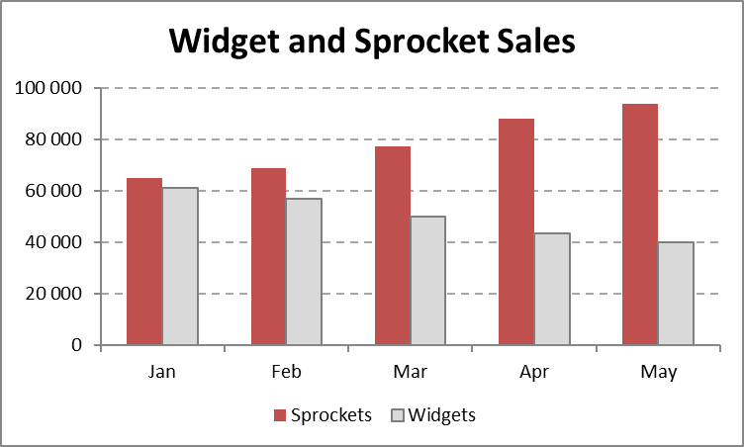
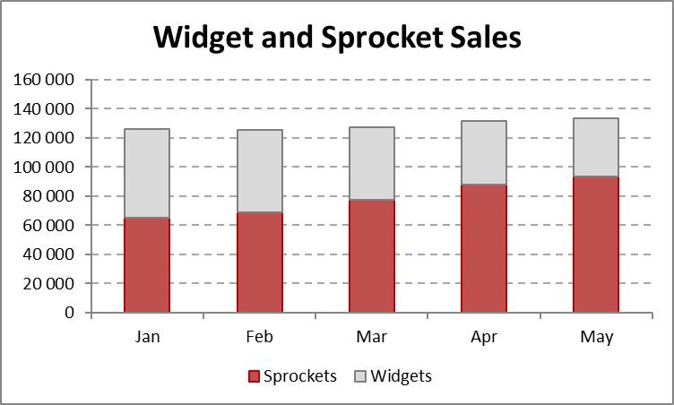
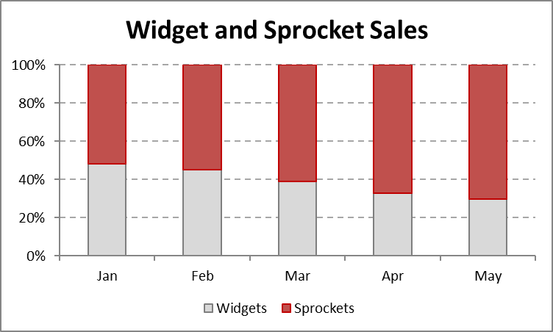
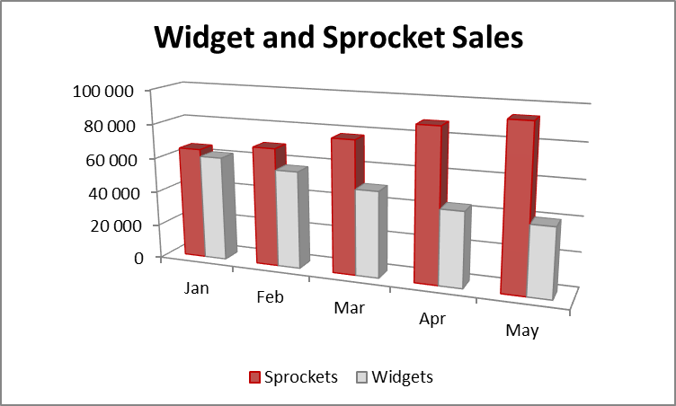
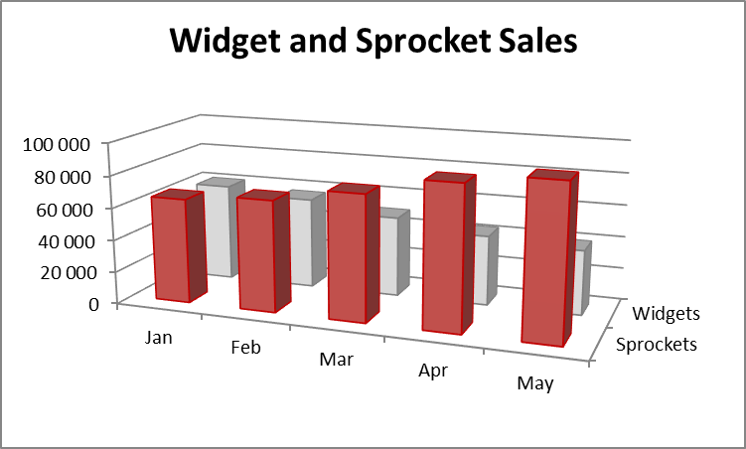
This clustered column chart compares monthly sales for two products.

Slide 16
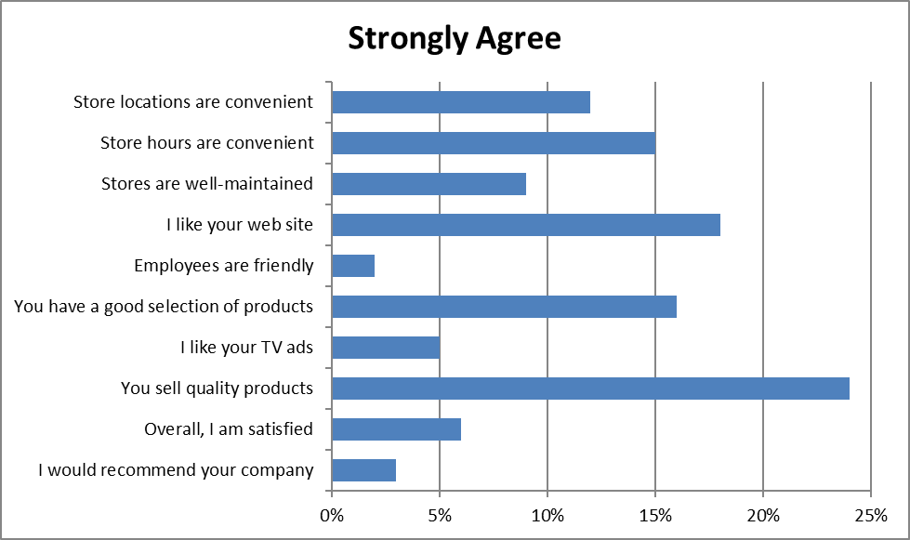
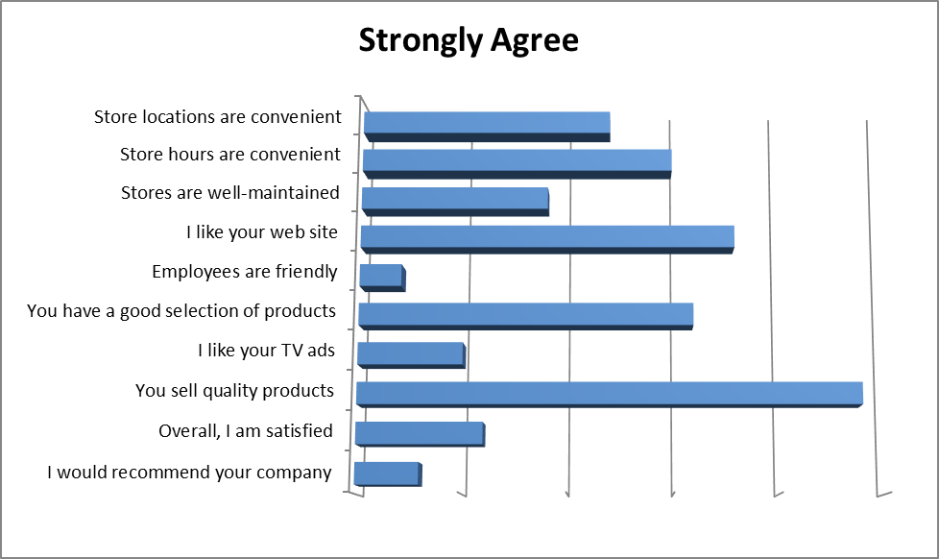
Bar charts
A bar chart is essentially a column chart that has been rotated 90 degrees clockwise.
One distinct advantage to using a bar chart is that the category labels may be easier to read.

Slide 17
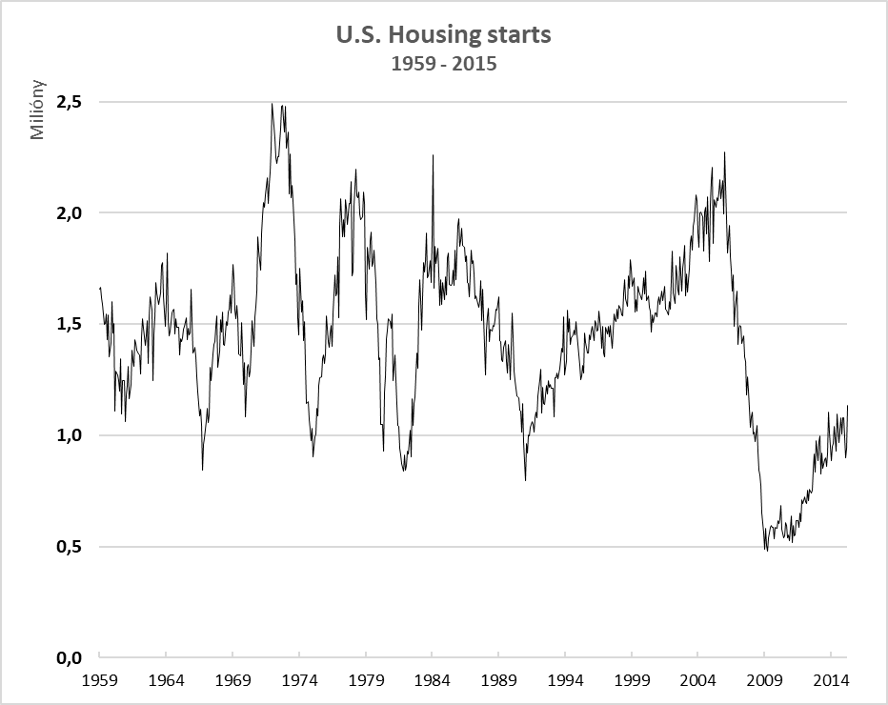
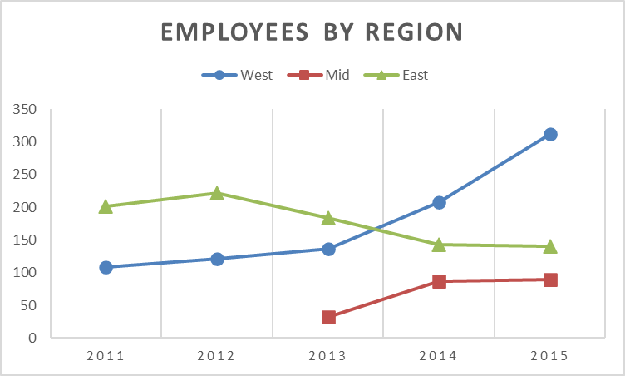
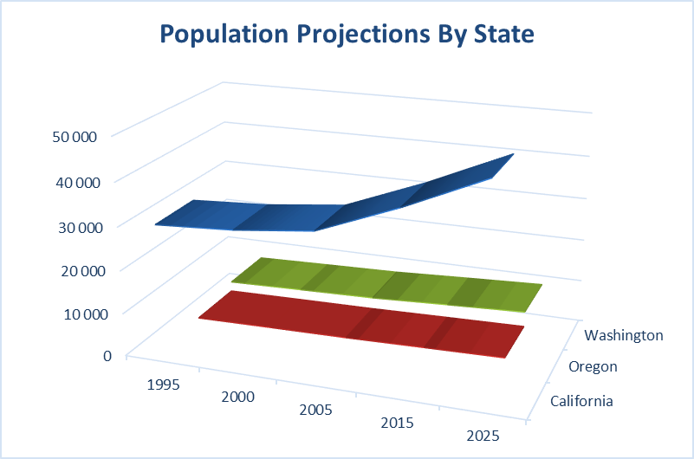
Line charts
Line charts are often used to plot continuous data and are useful for identifying trends.
Normally, the category axis for a line chart displays equal intervals.
A line chart can use any number of data series, and you distinguish the lines by using different colors, line styles, or markers.

Slide 18
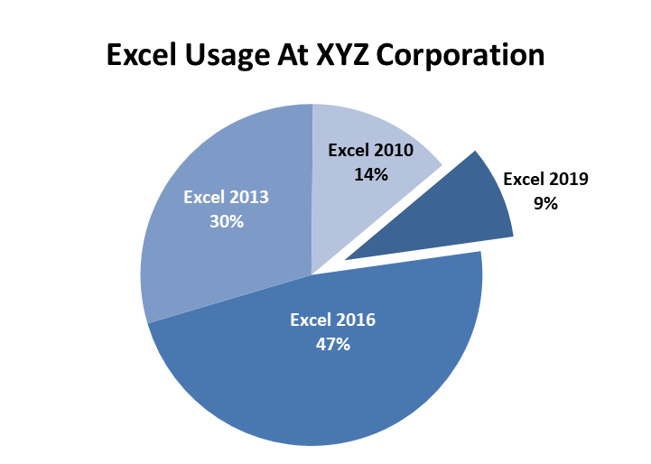
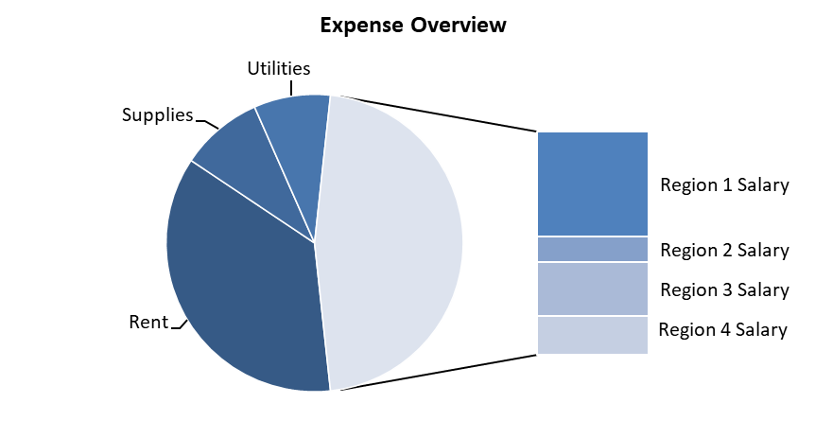
Pie charts
A pie chart is useful when you want to show relative proportions or contributions to a whole.
A pie chart uses only one data series.
Pie charts are most effective with a small number of data points.
Generally, a pie chart should use no more than five or six data points (or slices).

Slide 19
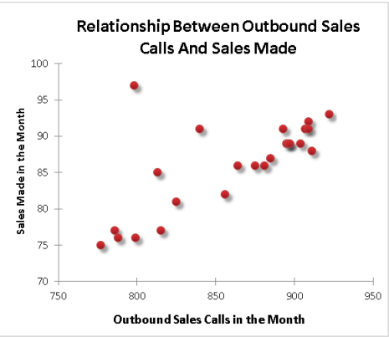
XY (scatter) charts
An XY chart differs from most other chart types in that both axes display values.
This type of chart often is used to show the relationship between two variables.

Slide 20
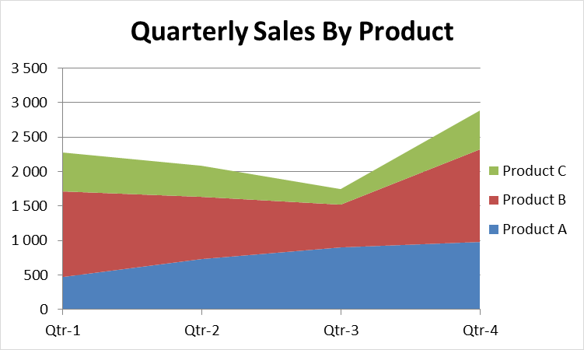
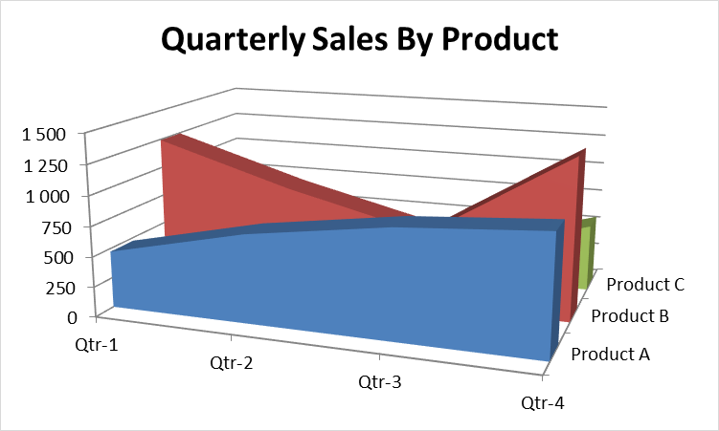
Area charts
Think of an area chart as a line chart in which the area below the line has been colored in.
Stacking the data series enables you to see the total clearly, plus the contribution by each series.

Slide 21
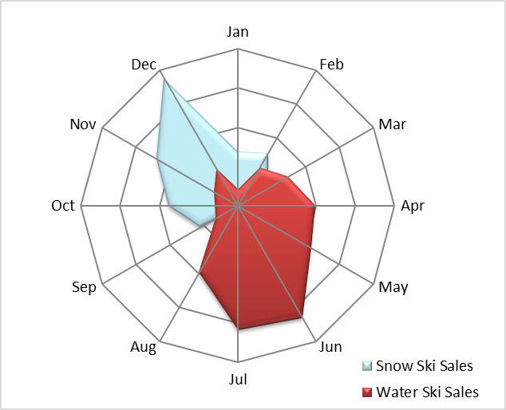
Radar charts
A radar chart is a specialized chart that has a separate axis for each category, and the axes extend outward from the center of the chart.
The value of each data point is plotted on the corresponding axis.

Slide 22
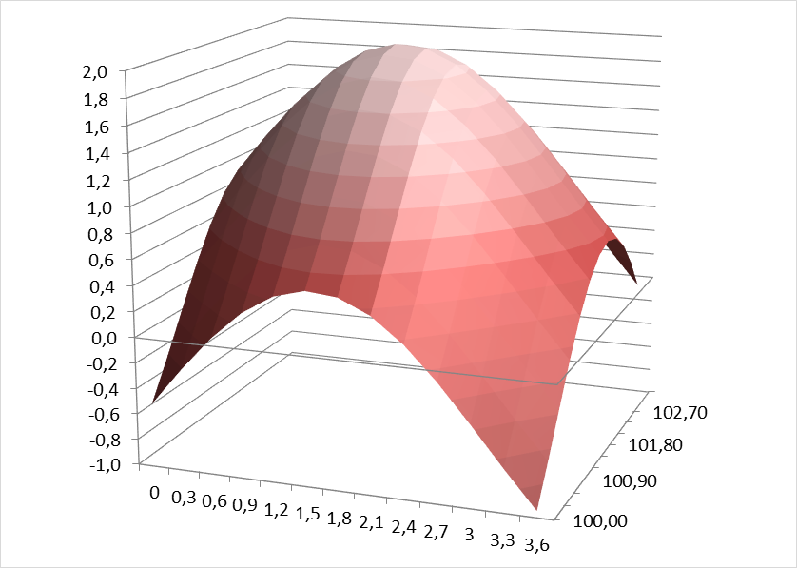
Surface charts
Surface charts display two or more data series on a surface.
Unlike other charts, Excel uses color to distinguish values, not to distinguish the data series.
The number of colors used is determined by the major unit scale setting for the value axis.
Each color corresponds to one major unit.

Slide 23
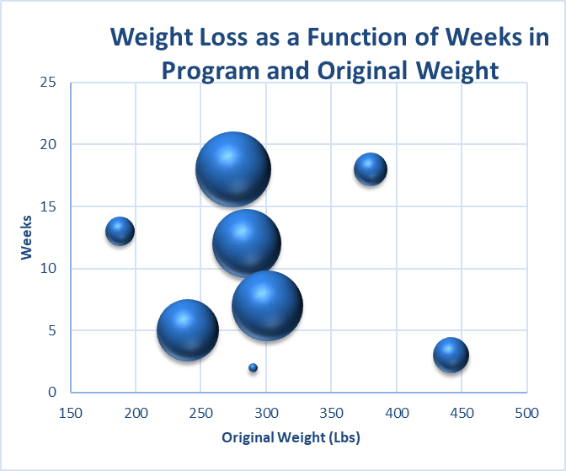
Bubble charts
Think of a bubble chart as an XY chart that can display an additional data series, which is represented by the size of the bubbles.
As with an XY chart, both axes are value axes.

Slide 24
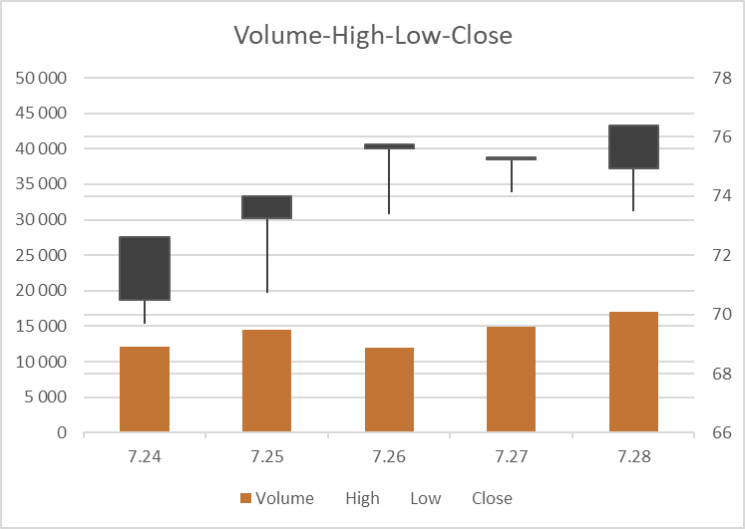
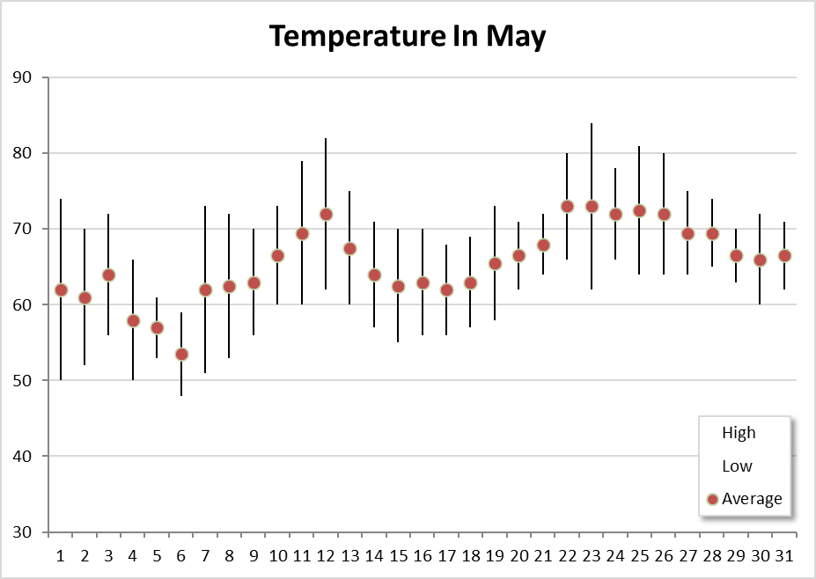
Stock charts
Stock charts are most useful for displaying stock-market information.
These charts require three to five data series, depending on the subtype.

Slide 25
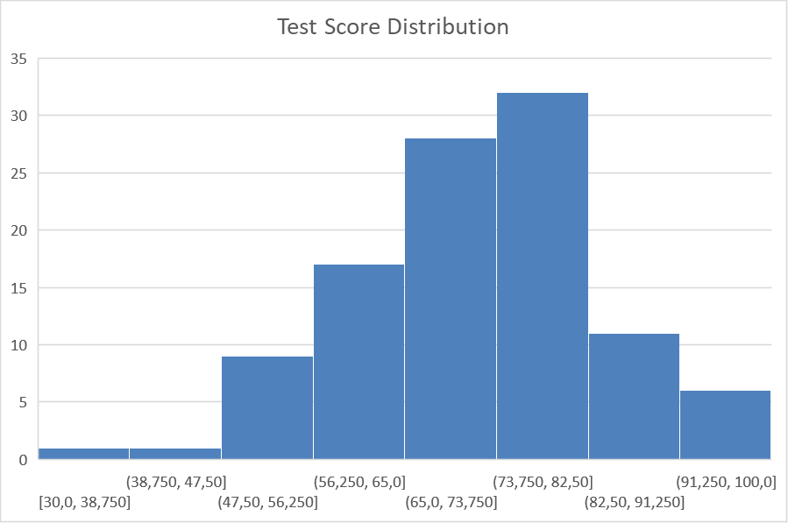
Histogram charts - new
A histogram displays the count of data items in each of several discrete bins.
The bins are displayed as category labels.

Slide 26
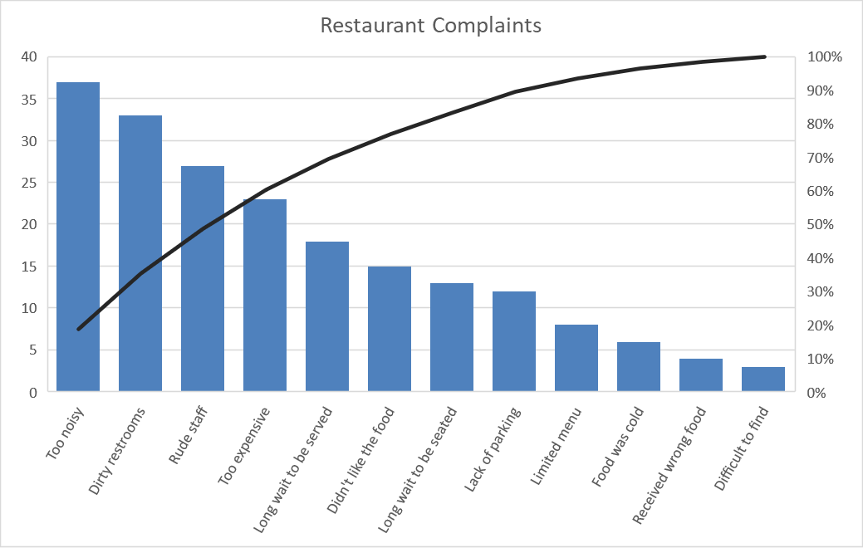
Pareto charts - new
The Pareto chart is a combination chart in which columns are displayed in descending order, and the columns use the left axis.
The line shows the cumulative percentage and uses the right axis.
Notes:
The line shows, for example, that approximately 50 percent of all complaints are in the top three categories.

Slide 27
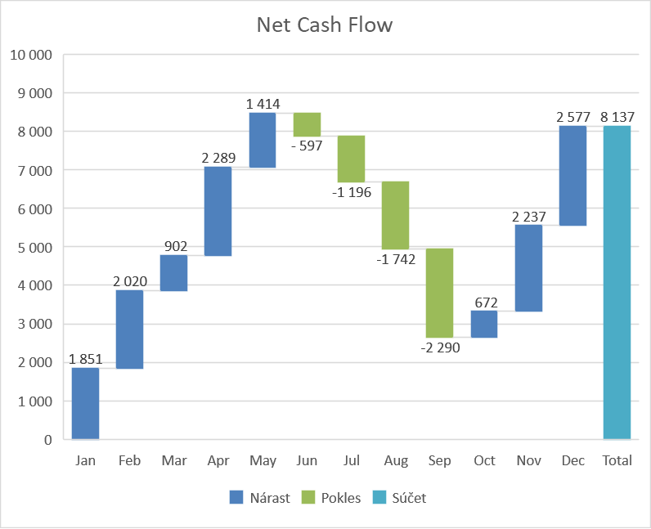
Waterfall charts - new
A waterfall chart is used to show the cumulative effect of a series of numbers, usually both positive and negative numbers.
The result is a staircase-like display.
Notes:
Waterfall charts typically display the ending total as the last bar, with its origin at zero. To display the total column correctly, select the column, right-click, and choose Set as Total from the shortcut menu.

Slide 28
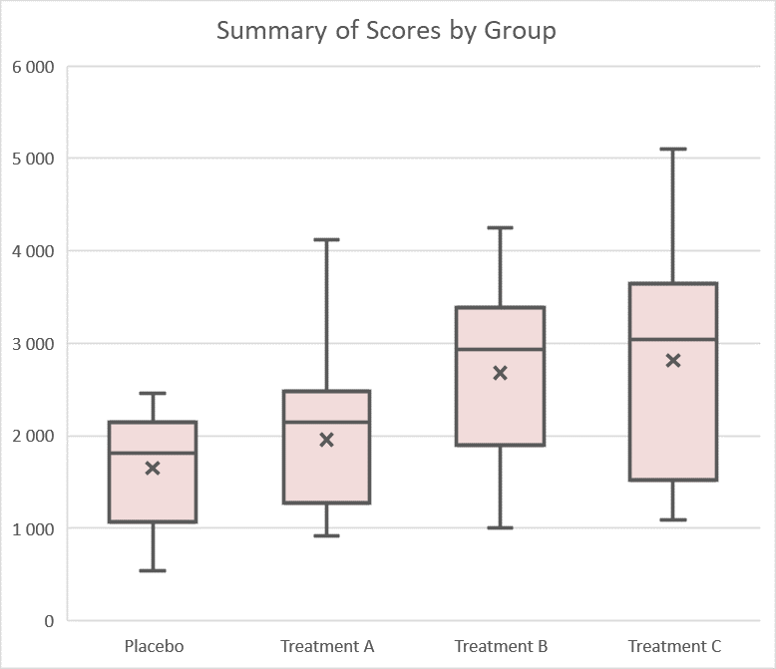
Box & whisker charts - new
A box & whisker chart is often used to summarize data visually.
In the chart, the vertical lines extending from the box represent the numerical range of the data (minimum and maximum values).
The “boxes” represent the 25th through the 75th percentile.
The horizontal line inside the box is the median value (or 50th percentile), and the X is the average.
This type of chart enables the viewer to make quick comparisons among groups of data.

Slide 29
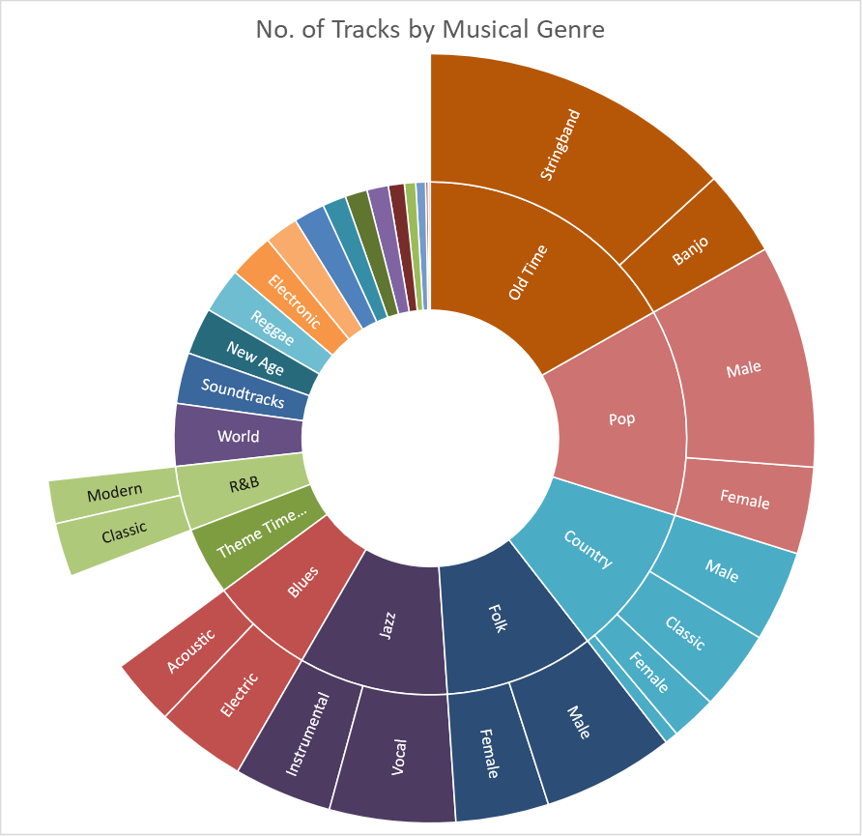
Sunburst charts - new
A sunburst chart is like a pie chart with multiple concentric layers.
This chart type is most useful for data that’s organized hierarchically.

Slide 30
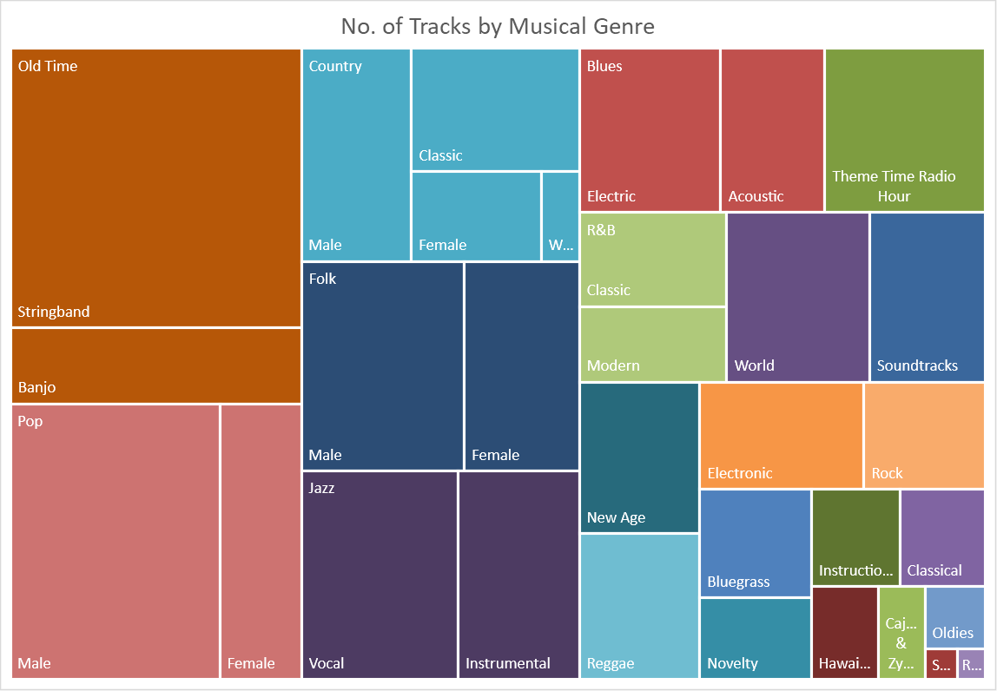
Treemap charts - new
Like a sunburst chart, a treemap chart is suited for hierarchical data.
The data, however, is represented as rectangles.

Slide 31
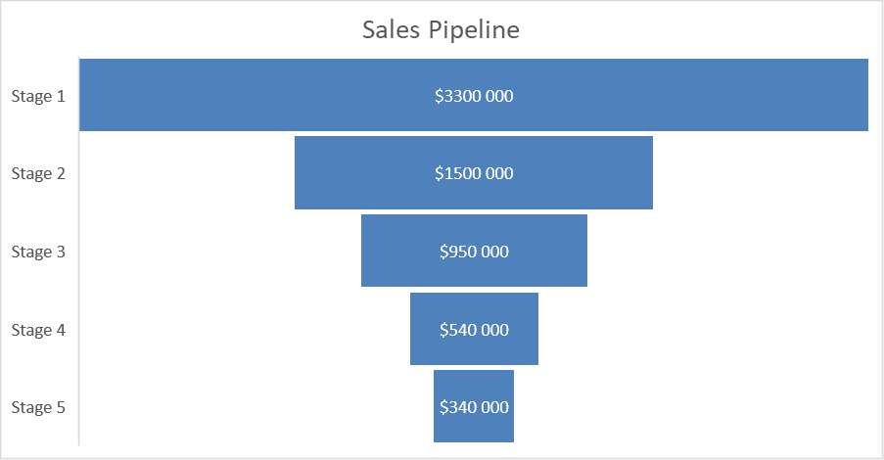
Funnel charts - new
Funnel charts are ideal for representing the relative values in each stage of a process.
These charts are typically used to visualize sales pipelines.

Slide 32
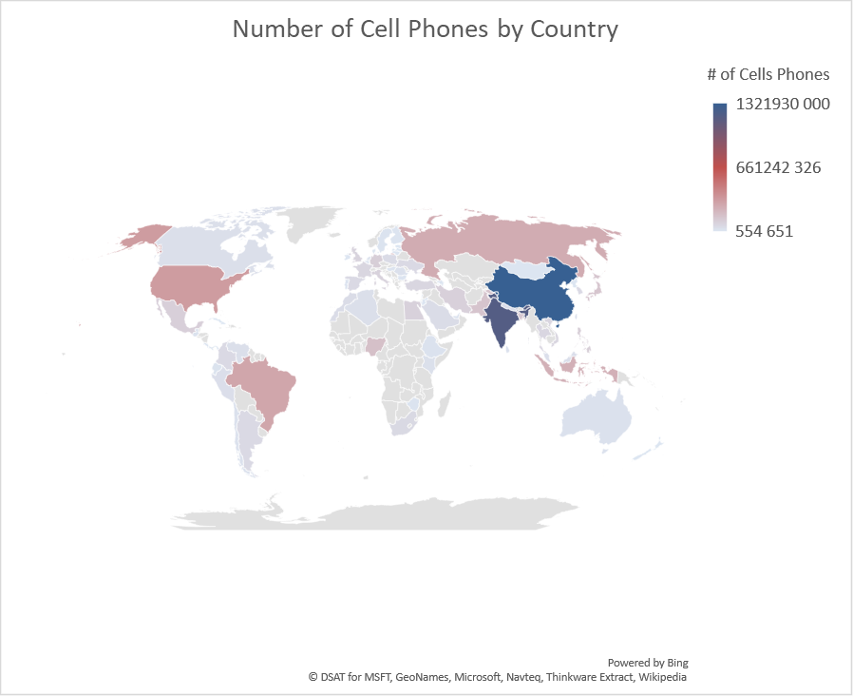
Map charts - new
Map charts leverage Bing maps to render location-based visualizations.
All you need to provide this chart are location indicator.
Map charts are remarkably flexible, allowing you create a chart based on province names, county names, cities, and even ZIP codes.

Slide 33
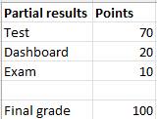
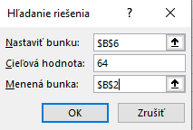
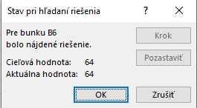
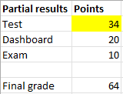
Goal seek
Determines the value that you need to enter in a single input cell to produce a result that you want in a dependent (formula) cell.
Single-cell goal seeking is a rather simple concept.
Excel determines what value in an input cell produces a desired result in a formula cell.
Example: Final exam from this subject consist of three parts – test, dashboard and exam. Question is: What is the minimum number of points that I need from the test to have an E exam?
The cell that Goal Seek changes must be referenced by the formula in the cell that you specified in the Set cell box.

Slide 34
Thank you for your
attention!

